Slide 1
Customer Success Management
Introduction & Positioning

Slide 2
Agenda
Welcome and Introduction
Tell us about yourself!
CSM Motivation & Service Offer
Role, scope, and differentiation
Collaboration process
Achieve rapid improvements with best practice
Your specific benefit
Your discussed Improvements
Next steps
The next steps in the process

Slide 3
Welcome and Introduction
Tell us about yourself!

Slide 4

We are curious! Please tell us about yourself!
What is your name?
How long have you been working for the company?
What is your role and scope?
What are your responsibilities?
It’s nice to meet you!

Slide 5
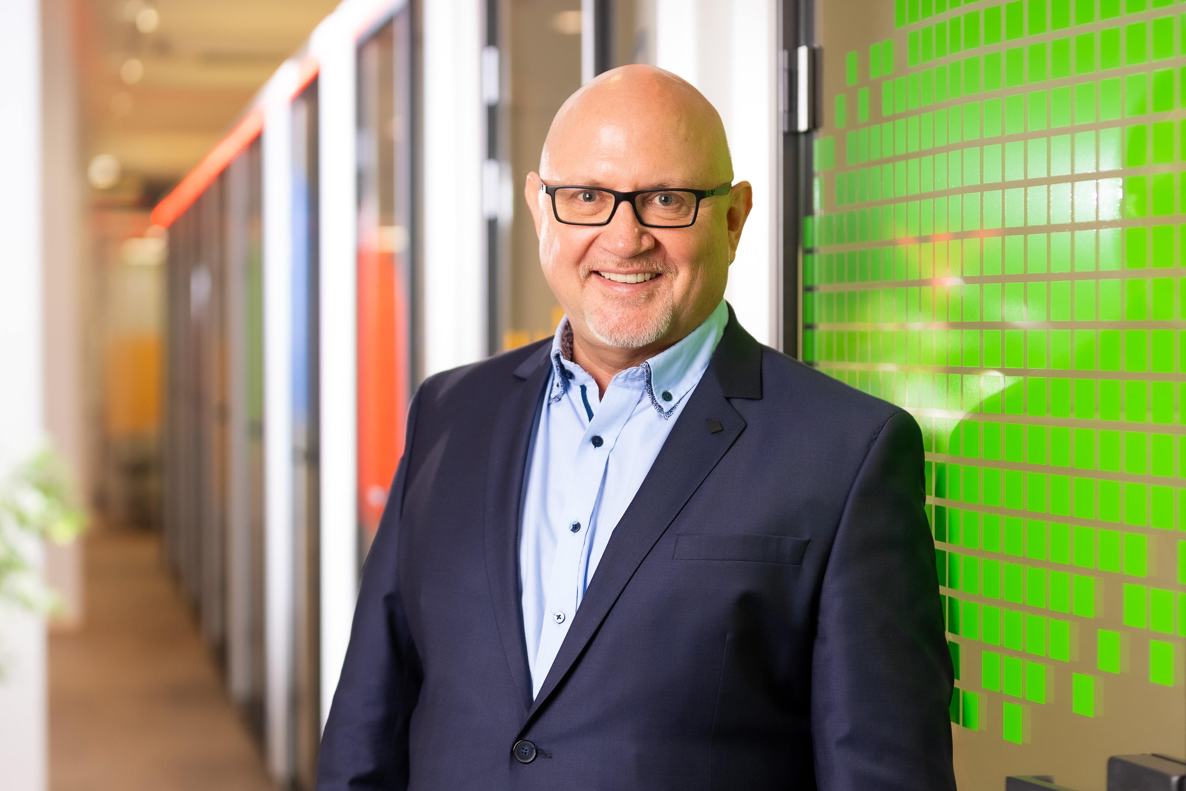
Michael Denninger
Director Customer Success Management
Michael.Denninger@hubdrive.com
+49 931 660 8460
linkedin.com/in/michael-denninger-7748144b

Slide 6
CSM Motivation & Service Offer
Role, scope and differentiation

Slide 7

Your success is our motivation
With us, every customer has a personal Success Manager.
This experienced consultant accompanies you during the initial implementation and continuously supports you in achieving further improvements in your HR management.
" I ensure that you utilize the full potential of the software for your company.”

Slide 8

Service offer Hubdrive CSM
Service Offer
Advice directly from the manufacturer, saving on consulting costs
Assisting in the selection of an implementation partner
Support to quickly achieve initial improvements
Coaching, moderation, sparring partner, and escalation at management level
Recommendation of best practice approaches that have proven successful with customers in your industry
Continuous support in planning and prioritizing improvements in HR management
Further suggestions for digitizing your HR department
Identification of previously unknown potential for improvement
What we do not do
Business consulting
Project management and support
Customizing, development or integration
You can‘t buy anything from me

Slide 9
Position distinctions
Hubdrive CSM
Accelerate initial improvements in HR management, e.g., to secure ROI
Identifying further potential for improvement beyond the initial gains to enable even more savings and optimizations
Recommending proven best practices from your industry to save time and resources so you don't have to reinvent the wheel every time
Assisting in the selection of implementation partners who understand your specific needs and challenges
Hubdrive Product Support
Technical 2nd level support with experts who offer highly specific and detailed solutions
Providing a customer portal that is available around the clock to resolve most issues independently.
Providing and continuously improving the enormously comprehensive Learning Center.
Providing a customer newsletter with interesting news from Hubdrive, upcoming versions, and news from the HR industry.
Quarterly rollup updates with impressive new features, enhanced functionality, bug fixes, and much more.
Partner Implementation
End-user support as the first and quick point of contact for customer inquiries
Parter implements the software and contributes in-depth knowledge and practical experience
Works with the customer to develop a schedule and sets up project management
Ensures that key users can train their employees so that every employee can work confidently with the software
If customizations are necessary: adapts the software to the customer's needs
Microsoft Cloud
Support for Windows, Office 365 or Microsoft 365
Support for the availability of the cloud platform
Platform security
Regional data storage

Slide 10
Collaboration process
Achieve rapid improvements with best practice

Slide 11
Implementation phases
Get Hubdrive HR for Dynamics improvements in Consumption
License order
Connect and coordinate milestones
Establish initial improvements
…
Establish second improvements
continuous
Establish third improvements

Slide 12


Implementation phases
Order
Connect and coordinate milestones
Establish first improvement
Establish second improvement
Establish third improvement
…
Internal communication of the upcoming milestone and its improvements
Technical setup (more extensive at milestone 1)
Training on the necessary features for the milestone
Customizing Prioritization and Implementing Priority 1
Data Migration to Milestone
Key Group usage and provide support
Make advantages transparent, develop key group into fans
Training of all employees by the Key Group
Use of functions and digitized processes by all affected employees
Make usage transparent and close gaps in usage
2
1
3
4
7
8
9
10
5
6
0
Decision to implement Improvements
Decide on the next improvements to implement

Slide 13

Successfully implementing Hubdrive
Internal implementation with IT & HR
Implementation with Hubdrive certified partner

Slide 14







































Hubdrive worldwide partner ecosystem

Slide 15
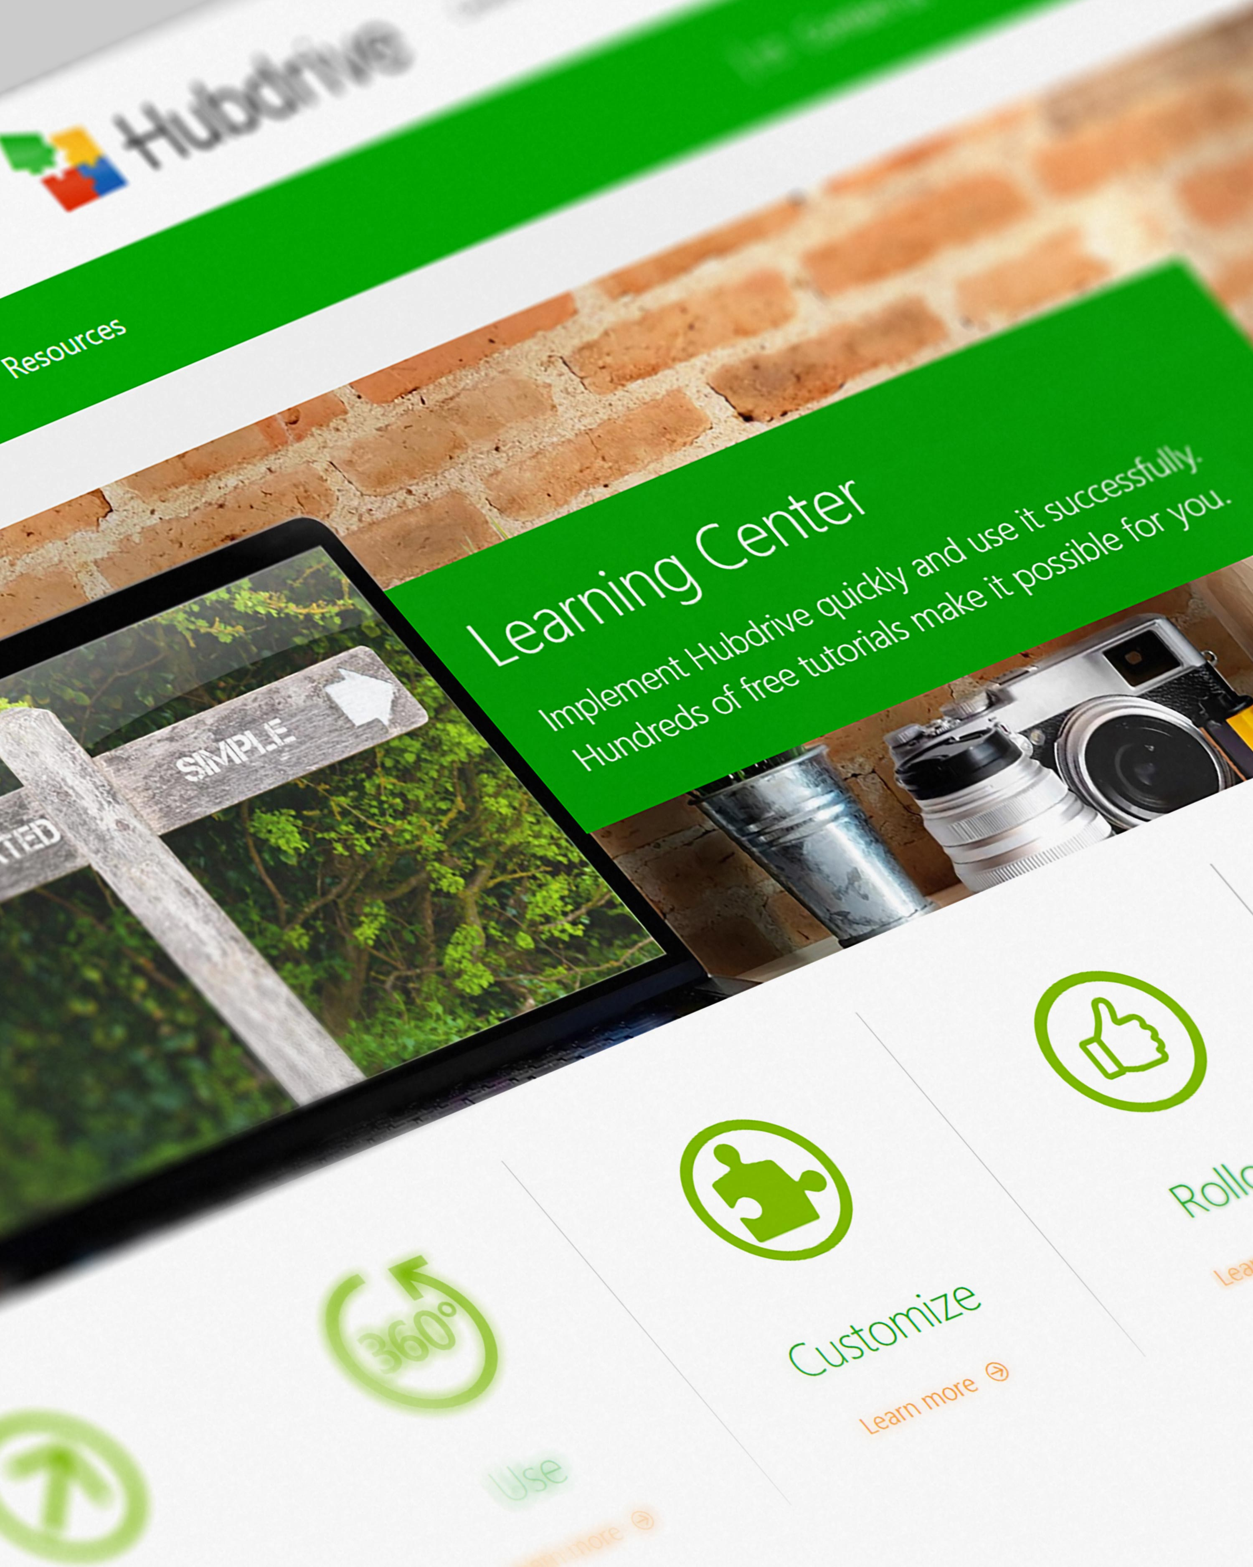
Hubdrive Self-Services
www.hubdrive.com/en/learn
Hubdrive Learning Center
Implement Hubdrive quickly and use it successfully. Hundreds of free tutorials make it possible for you.
Easy to use and available 24/7
www.hubdrive.com/en/learn
Hubdrive Customer Portal
Access the latest information. Create support requests and/or check the status of your tickets.
Solve most problems yourself.
Available around the clock.
portal.hr-for-dynamics.com

Slide 16

Best Practice Implementation in 10 steps
Establishing a process for improvement
Partner or Self-Implementation via E-Learning
Internal communication of the upcoming milestone and its improvements
Technical setup (more extensive at milestone 1)
Training on the necessary features for the milestone
Customizing Prioritization and Implementing Priority 1
Data Migration to Milestone
Key Group usage and provide support
Make advantages transparent, develop key group into fans
Training of all employees by the Key Group
Use of functions and digitized processes by all affected employees
Make usage transparent and close gaps in usage
2
1
3
4
7
8
9
10
5
6

Slide 17

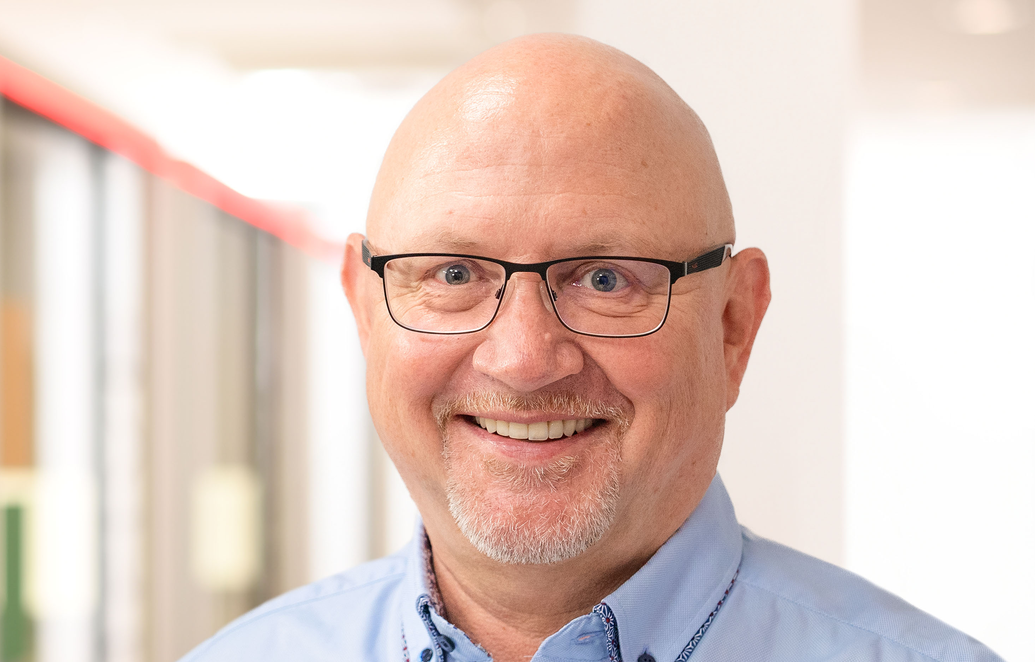









CSM Communication Matrix Hubdrive, Microsoft, Partner & Customer
Team Hubdrive
Implementation Partner
Support Portal
E-Learning Portal
C-Level
CSM
Sales
Hubdrive Support
Project Manager
Consulting & Support
Hubdrive E-Learning
Strategic topics if needed
Improvements
Milestones
Bi-weekly
Licenses Reorders
Technical product issues.
Upon request
Implementation
continuously
Enduser-Support
upon request
Usability and Application problems If needed
C-Level
HR Director
HR
Project Manager
Key User
Customer
Notes:
Holger mit Carmen tauschen
Tobias P. oder TKO?
Wo kommt Holger hin?

Slide 18



IT platform for collaboration
Die Plattform stellt Hubdrive ohne zusätzlichen Kosten
Customer
CSM

Slide 19
Your specific Benefit
Improvements developed with your team in the process to date

Slide 20
Your agreed improvements (example)
Improvement 1: Recruiting Efficiency
We aim to improve and simplify our recruiting process by December 31. Specifically, we want to save 512 hours of administrative time and fill positions in 85 days instead of 180 days. Additionally, we want to use five more recruiting channels without additional effort.
Improvement 2: Time Tracking
We want to provide more convenience for employees in time tracking. We aim for easy operation and deep Teams integration. Department heads should be freed from the monthly Excel merge to use their time more meaningfully. We also welcome a time saving of 82 person-days per year. These improvements are to be implemented in two phases by September 30 and December 31 of next year in all plants.
Improvement 3: Integrated Working
We want to work in an integrated manner, specifically by replacing 6 programs (IT islands) in the HR department with an integrated solution by June 30 next year. We have strategically chosen the Microsoft Power Platform. Therefore, we want to replace the 6 programs with an HR solution based on this platform. We expect savings of €65,000 per year and more operational security through the Microsoft Cloud. Further programs will be replaced later.
Improvement 4: Benefits of Self-Services
In this area, we want more convenience for employees, better data security, and more efficiency. Employees should be able to query remaining vacation and other information at any time, maintain some master data themselves, and thus relieve the HR department of routine tasks. A time saving of 50+ person-days is expected. Implementation should be completed by the end of May.

Slide 21
Timeline Milestones Improvements (example)
# | Improvements | Du ration | Q1 |  |  | Q2 |  |  | Q3 |  |  | Q4 |  |  | Q1 |  |  | Q2 |  |  | Q3 |  |  | Q4 |  |  | Q1 |  |  | Q2 |  |  | Q3 |  |  | Q4
1​ | Recruiting Efficiency (Internal responsibility Ms. Both, Recruiting) | 120​ | ​ |  |  | ​ |  |  | ​ |  |  | ​ |  |  | ​ |  |  | ​ |  |  | ​ |  |  | ​ |  |  | ​ |  |  | ​ |  |  | ​ |  |  | ​
2 | Time tracking convenience (Internal responsibility Mr. Müller, Head of HR) | 90/90​ | ​ |  |  | ​ |  |  | ​ |  |  | ​ |  |  | ​ |  |  | ​ |  |  | ​ |  |  | ​ |  |  | ​ |  |  | ​ |  |  | ​ |  |  | ​
3​ | Integrated working (Internal responsibility Mr. Ton, Head of IT) | 180​ | ​ |  |  | ​ |  |  | ​ |  |  | ​ |  |  | ​ |  |  | ​ |  |  | ​ |  |  | ​ |  |  | ​ |  |  | ​ |  |  | ​ |  |  | ​
4 | Advantages of self-services (Internal responsibility Mr. Müller, Head of HR) | 60​ | ​ |  |  | ​ |  |  | ​ |  |  | ​ |  |  | ​ |  |  | ​ |  |  | ​ |  |  | ​ |  |  | ​ |  |  | ​ |  |  | ​ |  |  | ​
5 | Further milestone (tbd.) | -​ | ​ |  |  | ​ |  |  | ​ |  |  | ​ |  |  | ​ |  |  | ​ |  |  | ​ |  |  | ​ |  |  | ​ |  |  | ​ |  |  | ​ |  |  | ​
6​ | Further milestone (tbd.) | -​ | ​ |  |  | ​ |  |  | ​ |  |  | ​ |  |  | ​ |  |  | ​ |  |  | ​ |  |  | ​ |  |  | ​ |  |  | ​ |  |  | ​ |  |  | ​
Recruiting
Comfort T&A
Merge Time Tracking
Integration 6 apps
Self- Service
Integration additional apps

Slide 22
Next Steps
The next steps to success

Slide 23
Next concrete steps example
Establish communication
Activate IT platform for collaboration
Plan first milestone with partner and/or internal IT
Scheduling regular meetings (CSJ)
Sign the Data Processing Order (DPO)
Invitation to the customer portal (up to two users)

