Slide 1
Co-Market HR Fairs with Hubdrive
Hubdrive supports its partners in lead generation. The Marketing Toolbox offers the opportunity to participate in HR trade fairs in many countries around the world.
By booking a sponsor package in good time, the partner secures the opportunity to take part in the trade fair. The final decision is made by Hubdrive.

Slide 2
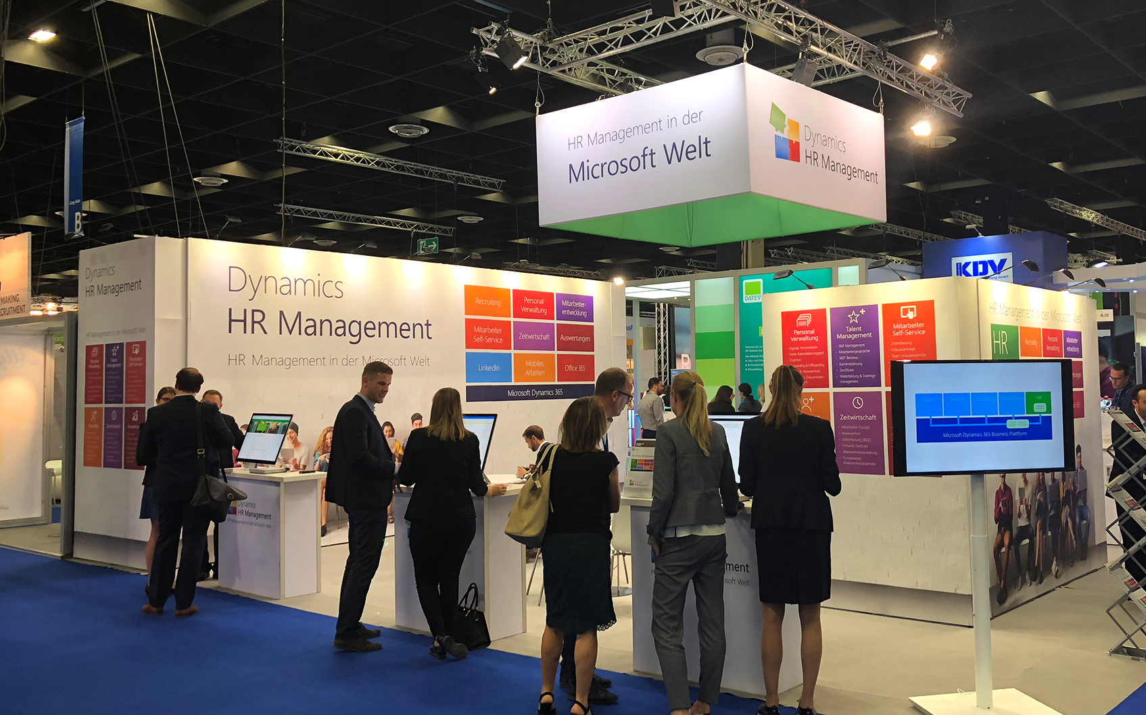
We have an exciting trade fair appearance, are very active at the booth and together with the brand HR management in the Microsoft world, generate great leads.
At the booth, our partners and Hubdrive's sellers work together. Everyone has their core competence and experience. Together we are a very good team. We complement each other in experience.

Slide 3
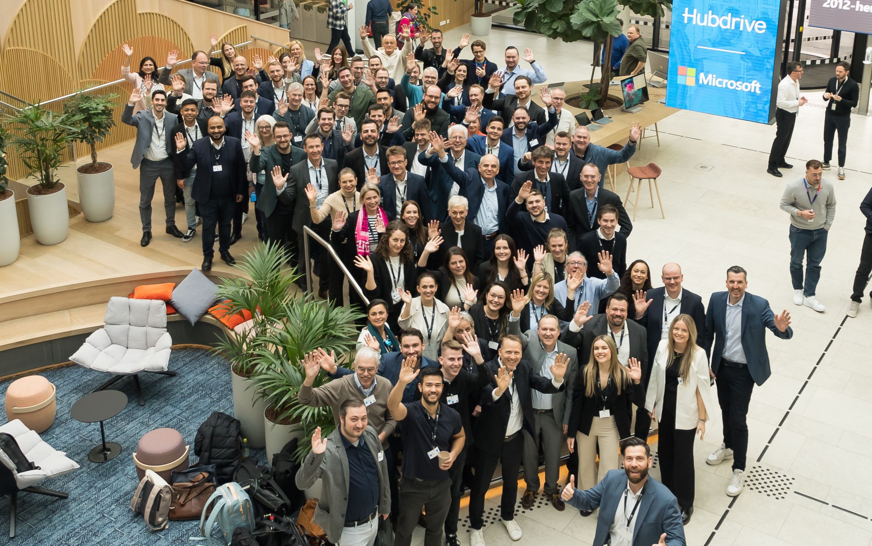
Be part of the Partner Ecosystem
Win-Win Partnership

Slide 4
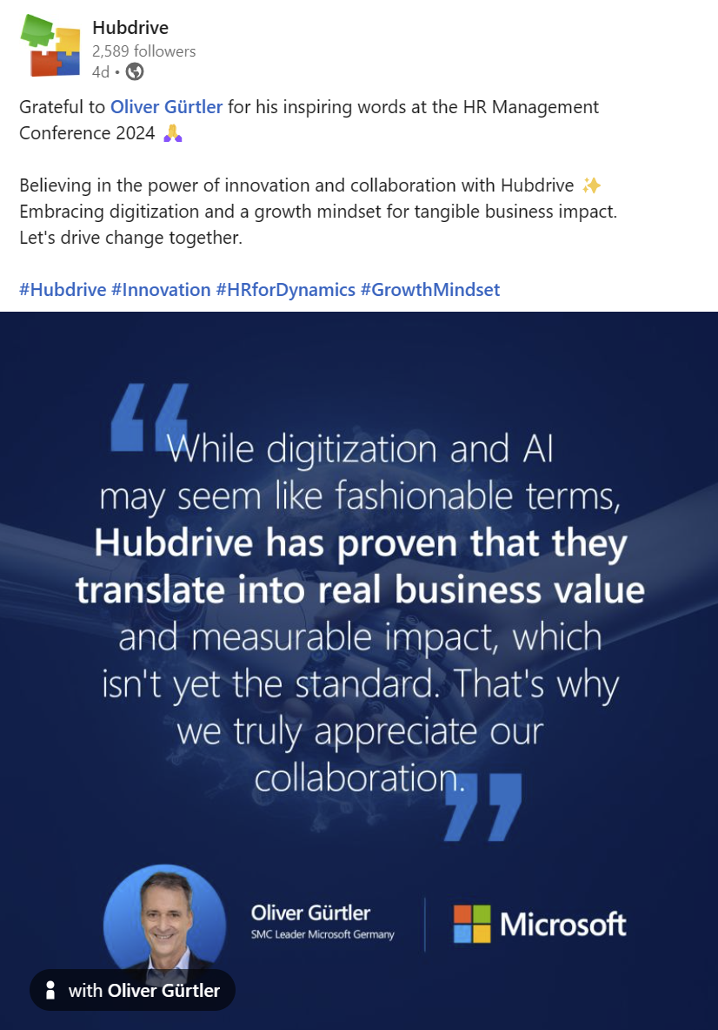
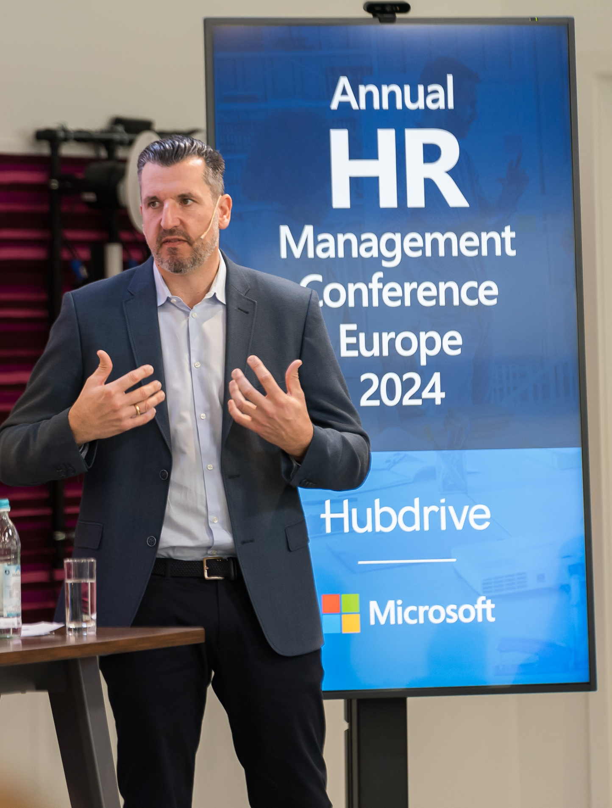
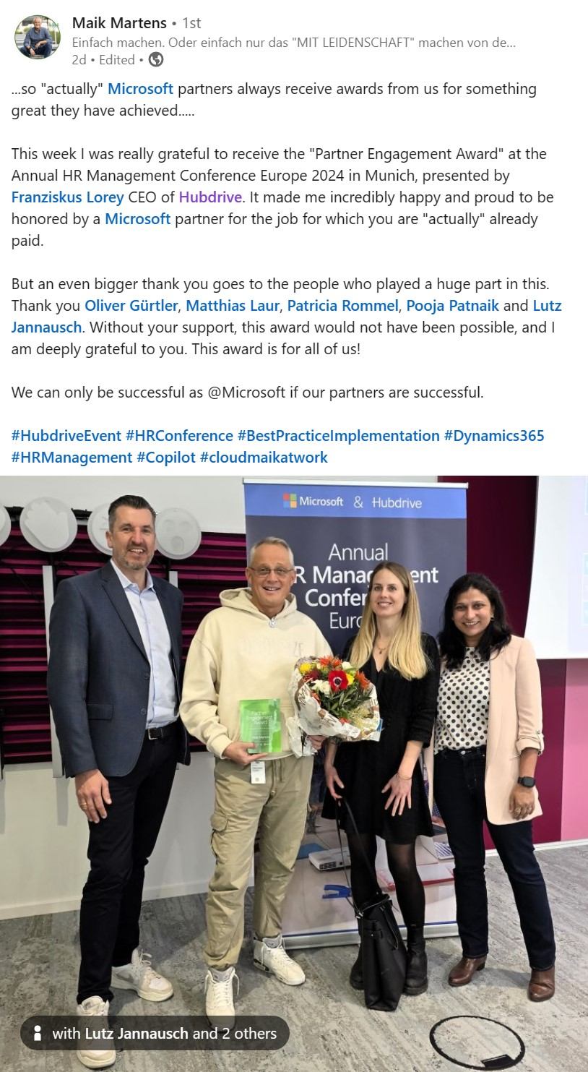
Be better recognized by Microsoft

Slide 5
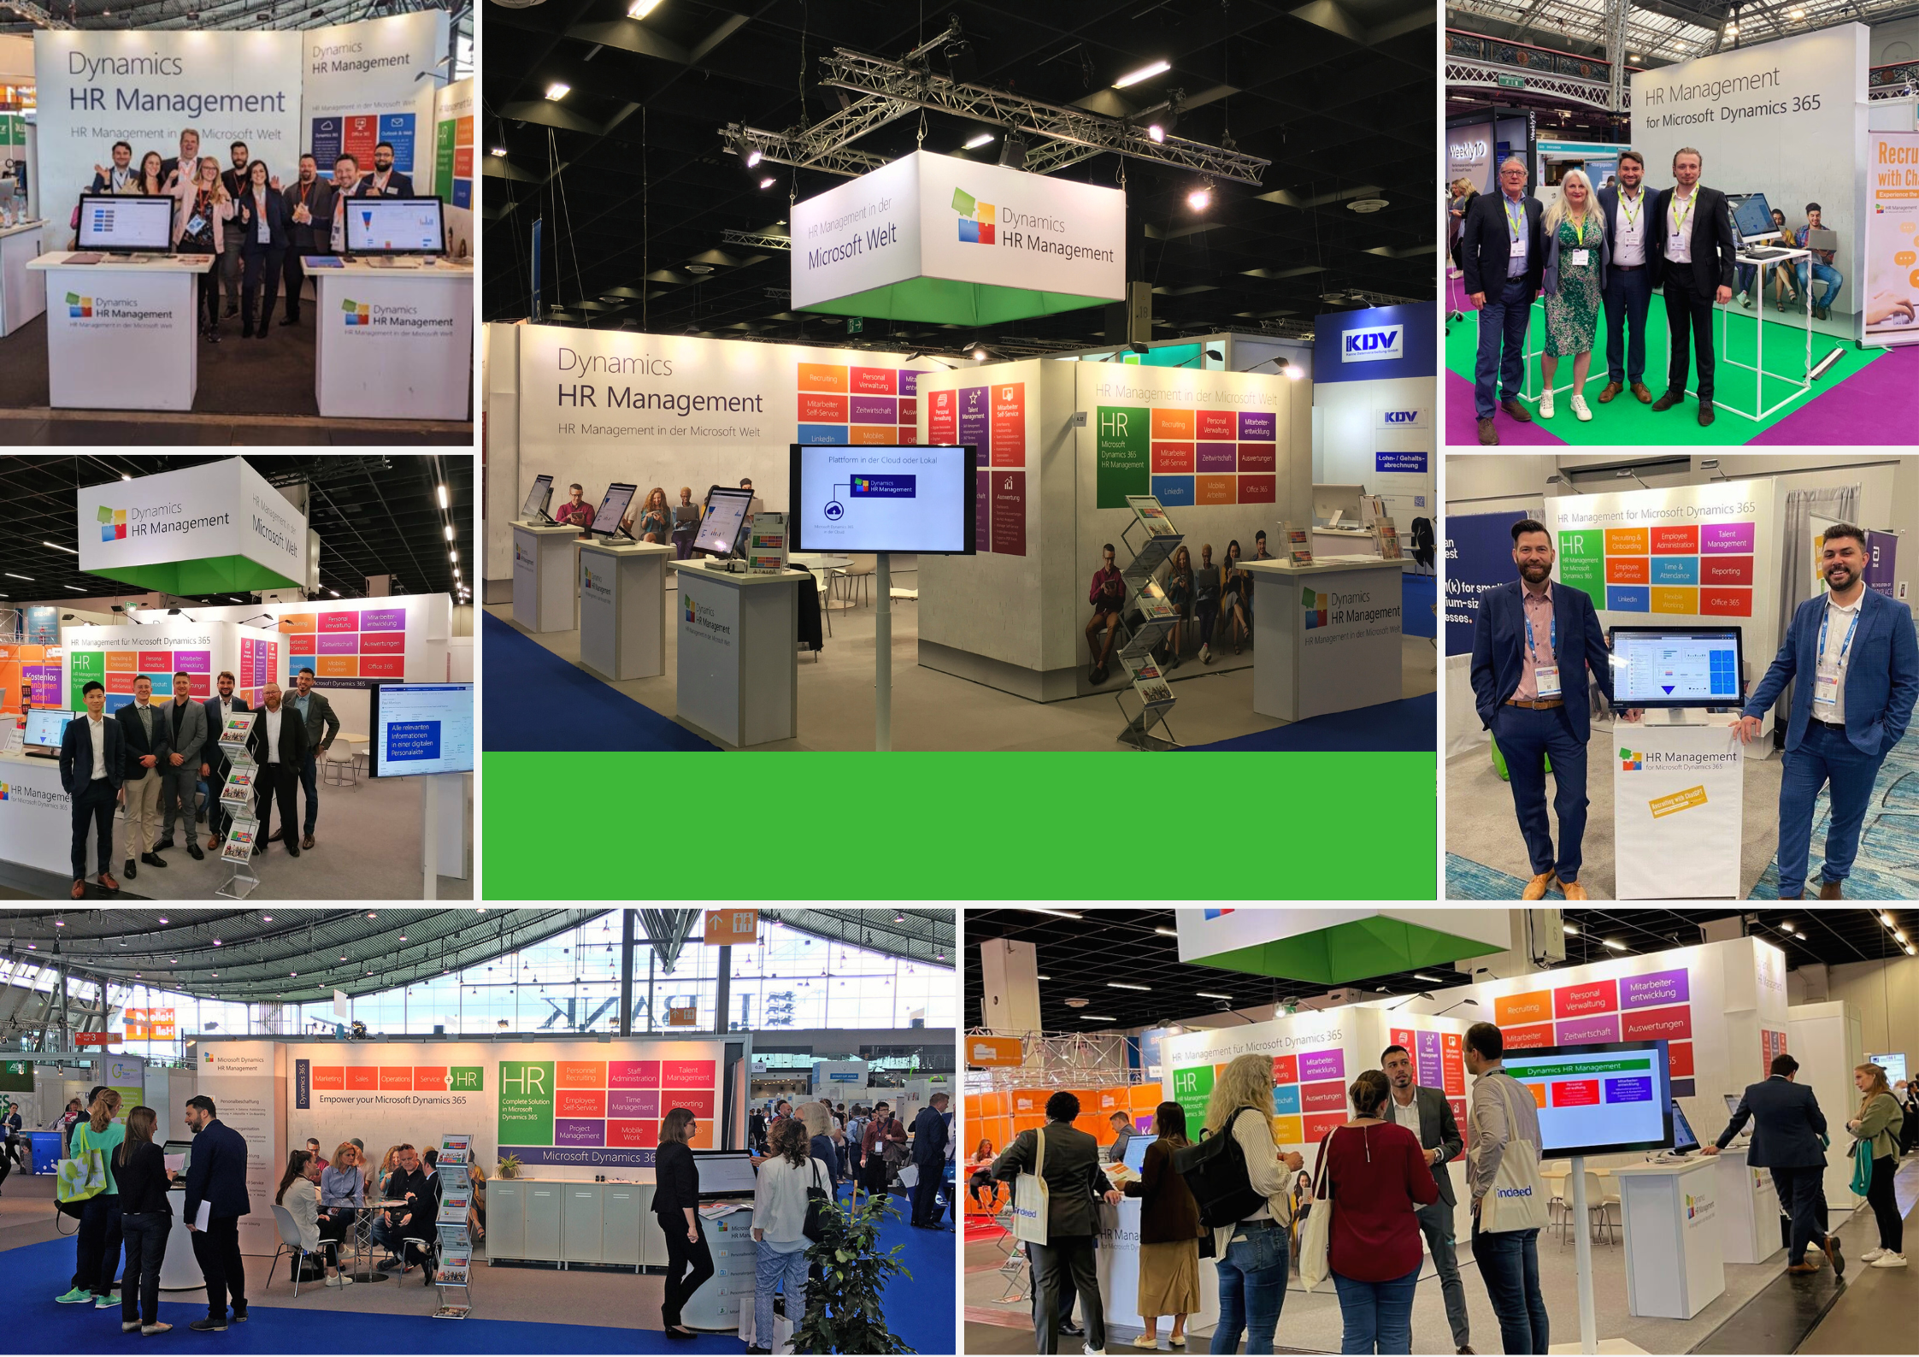
Examples
How does it look like

Slide 6
Customers we have met at fairs
Joint success through trade fairs
Financial Services
TMT
<100€
Sales accepted lead
>20
Pharma & Industrial
Public Institutions
Leads per fair-day
Automotive & Energy & Utilities
Food & Consumer
Latest enterprise wins via fairs
200.000+
Revenue after 12 month

Slide 7
Sponsor Package Benefits include
Preparation
Social Media
Access
Booth
Follow up
Free participation in trade fair trainings
Fair training material
Coaching if your first exhibition
10 posts on LinkedIn, Facebook and regional channels
Introduction to the other partners
6 nurturing E-Mails to prospects
Logo, Name and your company profile on the Websites
Digital Marketing Package for Social Media
Conference access full pass
WLAN Access
Your dedicated counter
Advertising material
Shared Hubdrive Senior Consultant
Dedicated Hubdrive Sales Consultant
Lead capture
Lead enrichment
Lead nurturing
Lead share via CSV
Lead conversion
Co-sell support

Slide 8
Advantages
Fast lead generation with personal contact
Contact with companies that are looking for a solution now
Build relationships with Hubdrive's sellers
Fast turnover through co-sell with Hubdrive

Slide 9
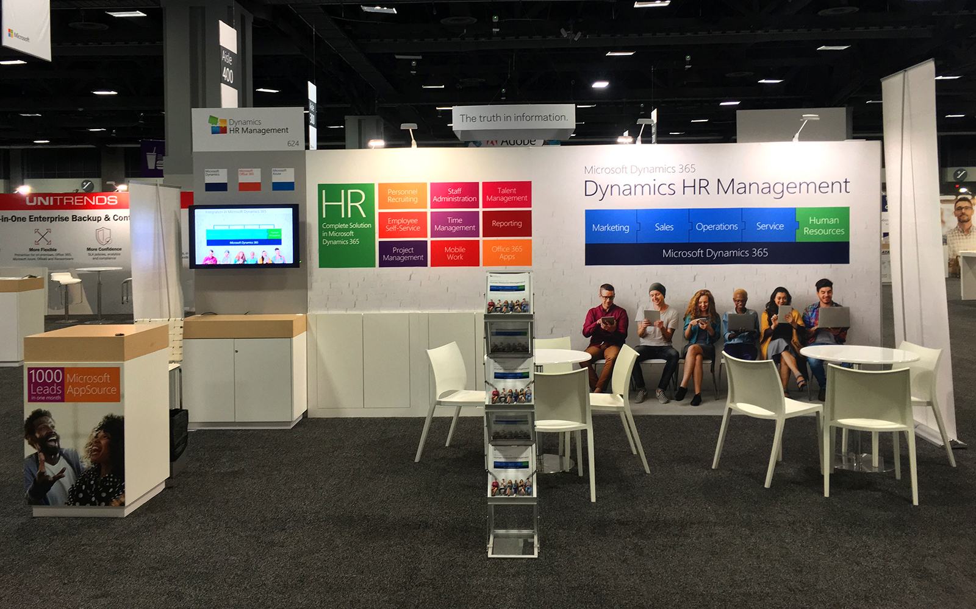
Tradeshow calendar
https://www.hubdrive.com/en/news/events.htm

Slide 10
Lead registration process
All Leads will be registered with dictaphones on the fair. This fast and efficient way, to gather and transfer Improvements to our CRM.
The Hubdrive Inside Marketing team captures all leads and enriches them. Within hours, all leads receive a thank you letter by e-mail for their visit to the trade fair. That makes a great impression. This service is included in the Sponsor Packages.
On the day after the trade fair, Hubdrive clarifies internally who is following up which lead on the part of Hubdrive. Some partners do the same on their site, others only have one person to follow. In both cases, the responsible Hubdrive seller will immediately contact the responsible person of the partner. The strategy is discussed for all leads. The leads were made available to the partner in advance enriched as Excel CSV.
In cases where more than one Partner is on the Fair with Hubdrive, the Excel File will contain all Leads, the partner registered as well as a share of leads which Hubdrive employees registered. Hubdrive and the partner sellers will meet the day after the fair to discuss strategy for all leads.
Further sales activities are then carried out jointly.

Slide 11
Fair – Microsoft Power Platform Conference 2024
Location
Las Vegas
Date
18.09. – 20.09.2024
Target Audience
Prospects & Partners
Sponsor package
5.900 $

