Slide 2
Agenda
What we offer to customers
Innovative HR Management Software for the Microsoft Dynamics 365 business platform
Our positioning
Technical point of view and target markets
What we offer to customers
Innovative HR Management Software
What we offer to partners
Global HR competence center for the Microsoft Partner ecosystem
Hubdrive and Microsoft
Joint Venture on a personal level
Facts and Figures
KPIs about Hubdrive
7 Things Hubdrive does different
HR Management for Microsoft Dynamics 365

Slide 3
What we offer to customers
Hubdrive is manufacturer and distributor of innovative HR Management Software based on the Microsoft Dynamics 365 business platform

Slide 4
Our Vision
Our vision is to empower people and organizations around the world to take advantage of digital transformation in Human Resources. We want to make life easier for all employees and at the same time increase productivity.

Slide 5
Our focus
Hubdrive is the manufacturer of innovative HR Management Software in the Microsoft Dynamics 365 business platform
and the global HR competence center for the Microsoft Partner ecosystem.

Slide 6
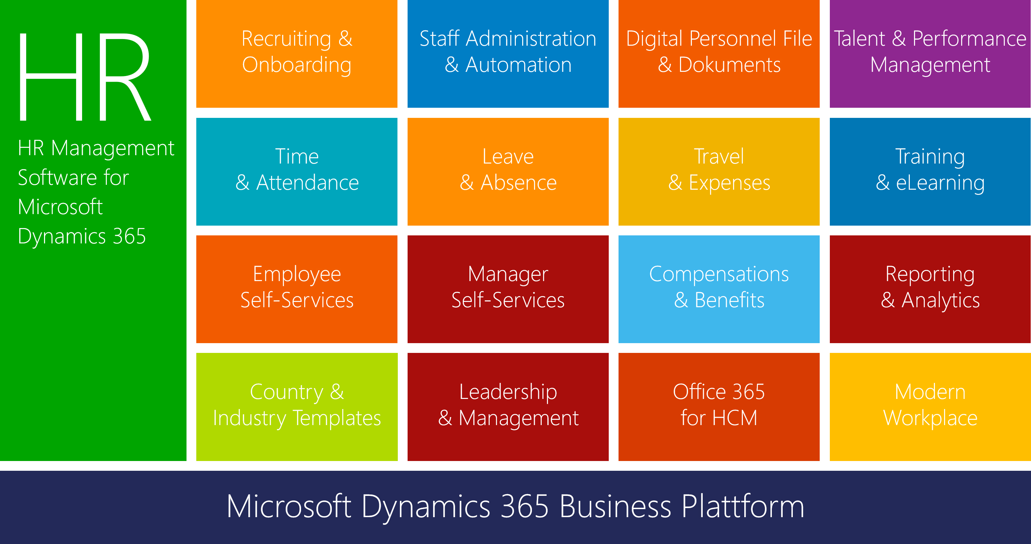
HR Complete Solution for Microsoft Dynamics 365

Slide 7
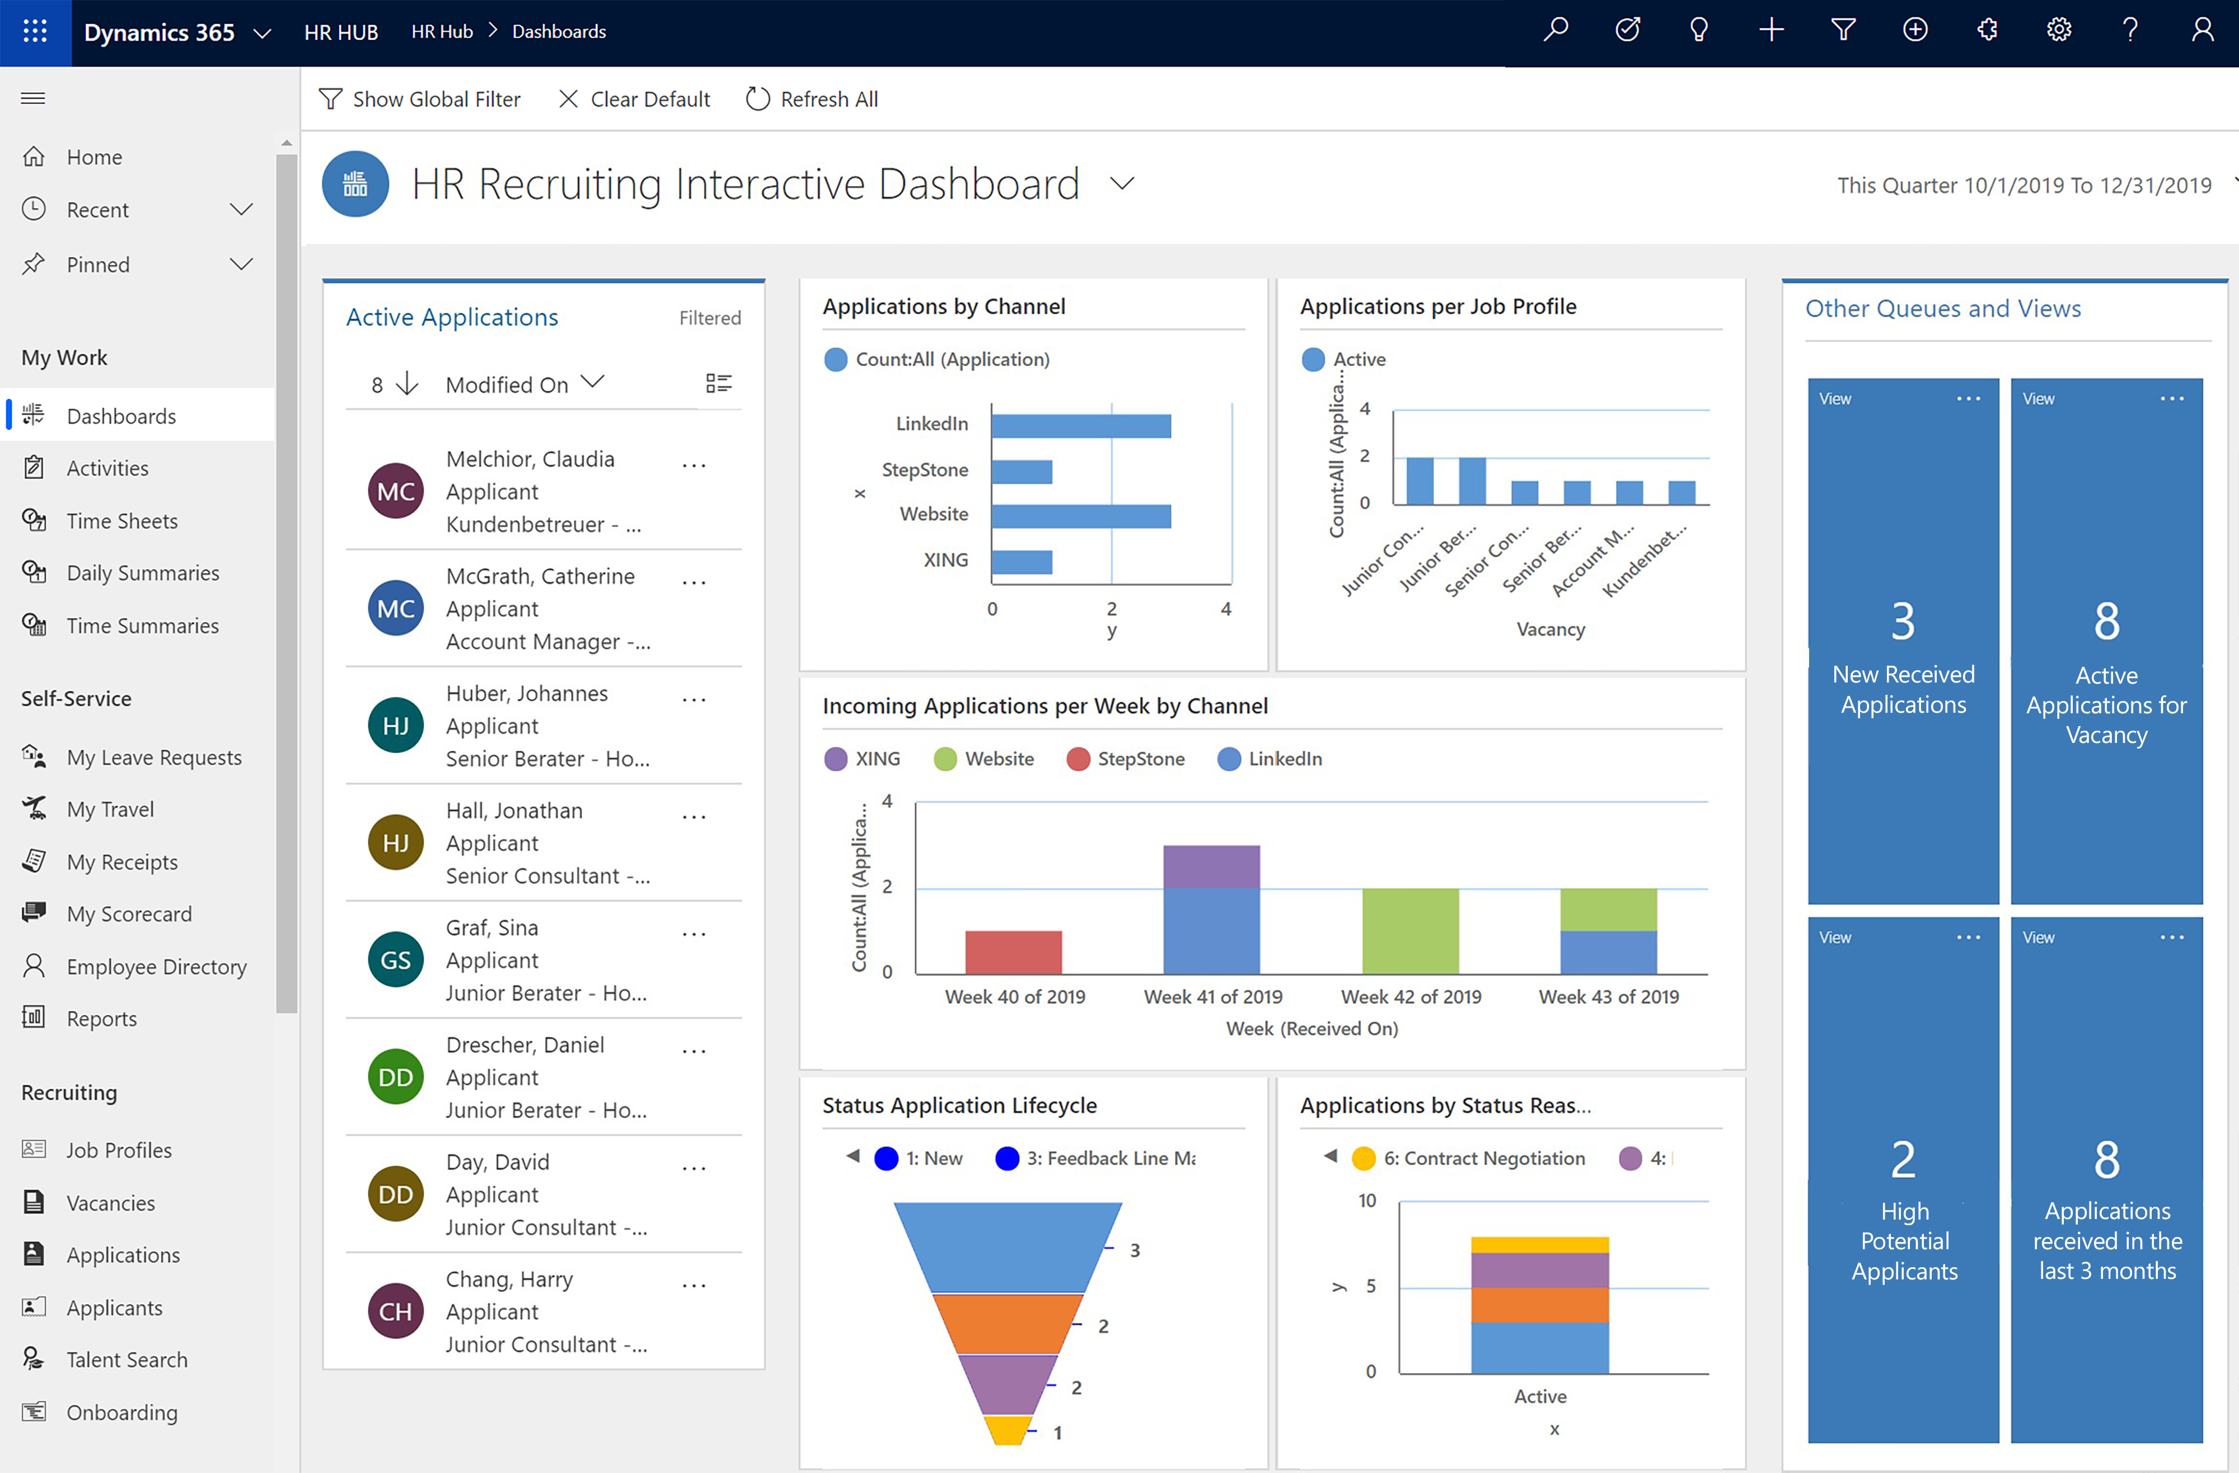
HR Management in Microsoft Dynamics 365
All the information you need at your fingertips - in just one cloud platform

Slide 8
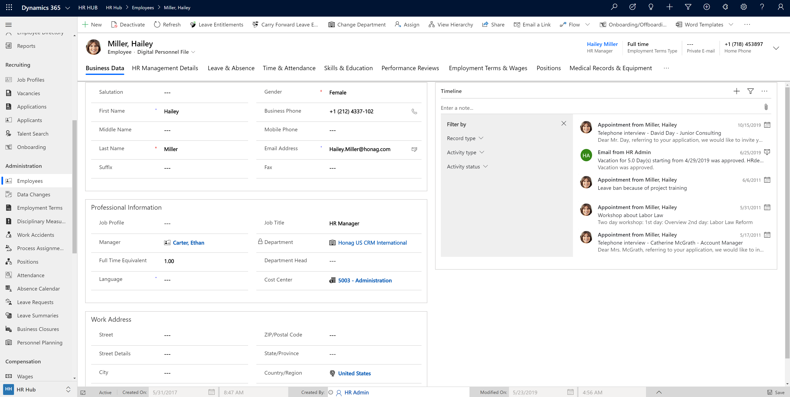
From recruiting, to personnel file to retirement

Slide 9
Hubdrive - our positioning
Technical point of view

Slide 10
HR Management Software for Microsoft Dynamics 365
Implementation
HR
Job Portals
LinkedIn, Federal Employment Agency (BA), Xing, StepStone, Google Job
and the own website.
Sales
Service
Marketing
Logistics
Finance
Payroll
ADP, SAP, sdworx, Datev,
Quickbooks
NP3...
Microsoft Dynamics 365 Business Plattform
Windows 11 and Microsoft Cloud Services
© Hubdrive.com

Slide 11
HR Management within the Microsoft Power Platform
Power Platform
Productivity
ERP
Microsoft
Office 365
Microsoft
Teams
Microsoft Sales
Microsoft
Dynamics Applications
Microsoft Marketing
Hubdrive
HR Management for Microsoft Dynamics 365
Microsoft
Finance & Operation
Microsoft Service
Hubdrive Digital
Personnel File
Hubdrive
Time & Attendance
Microsoft Dynamics 365
Dataverse
Finance and Operations
from Microsoft
© Hubdrive.com

Slide 12
The HR for Dynamics modules in the Dynamics platform
Power Platform
Productivity
ERP (BC & AX)
Microsoft
Office 365
Microsoft
Teams
Microsoft Sales
Microsoft Marketing
Microsoft Service
Finance
Commerce
Microsoft Field Service
Hubdrive Digital
Personnel File
Hubdrive
Time & Attendance
Project Operations
Supply Chain Management
Hubdrive
Recruiting
Hubdrive
HR Management
Hubdrive
Talent Manager
HCM
Benefit Management
Microsoft Dynamics 365
Dataverse
Finance and Operations
from Microsoft
© Hubdrive.com

Slide 13
Hubdrive - our positioning
Target Markets

Slide 14
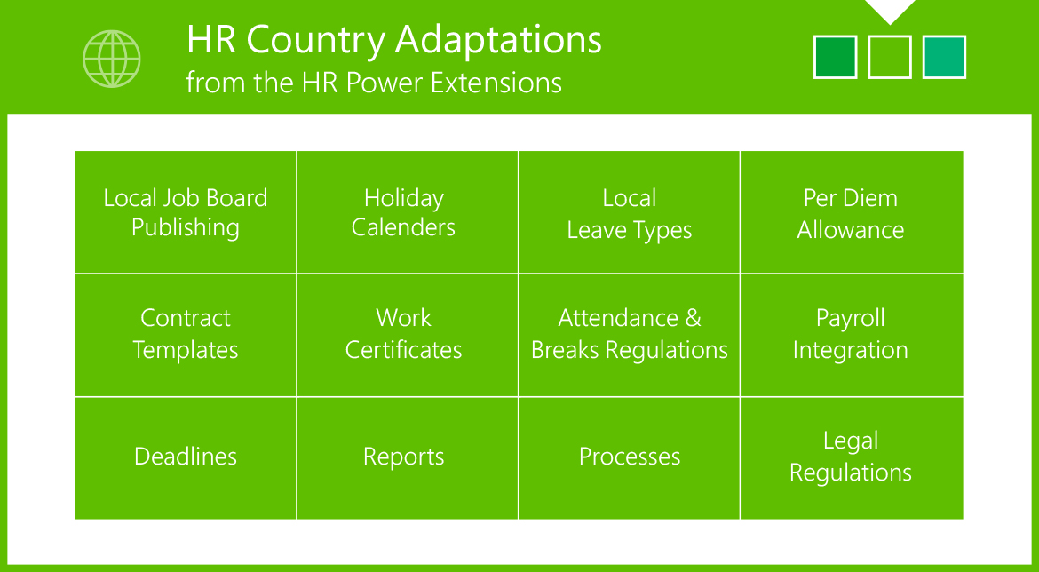
Markets we address
Countries
HR for Dynamics is available for 36 Countries. Country Templates from HR for Dynamics ensure that the HR solution is already adapted out-of-the-box to the respective country.
Support
Our Support is available 24x7 in all time zones.
Segments
Due to its modular, flexible and scalable design, Hubdrive is suitable for all organizations, from small and medium-sized businesses to international corporations or government institutions.

Slide 15
What we offer to partners
Hubdrive is the global HR competence center for the Microsoft Partner ecosystem.

Slide 16
Services Hubdrive HR Partner Hub
GTM Services
Lead generation & qualification
Co-Sell
Presentation, evaluation and closing
Implementation Services
Best Practice Implementation & support
Build-with Services
Extend and adapt

Slide 17
Partner Communication Hub

Slide 18
Hubdrive and Microsoft
Joint Venture on a personal level

Slide 19
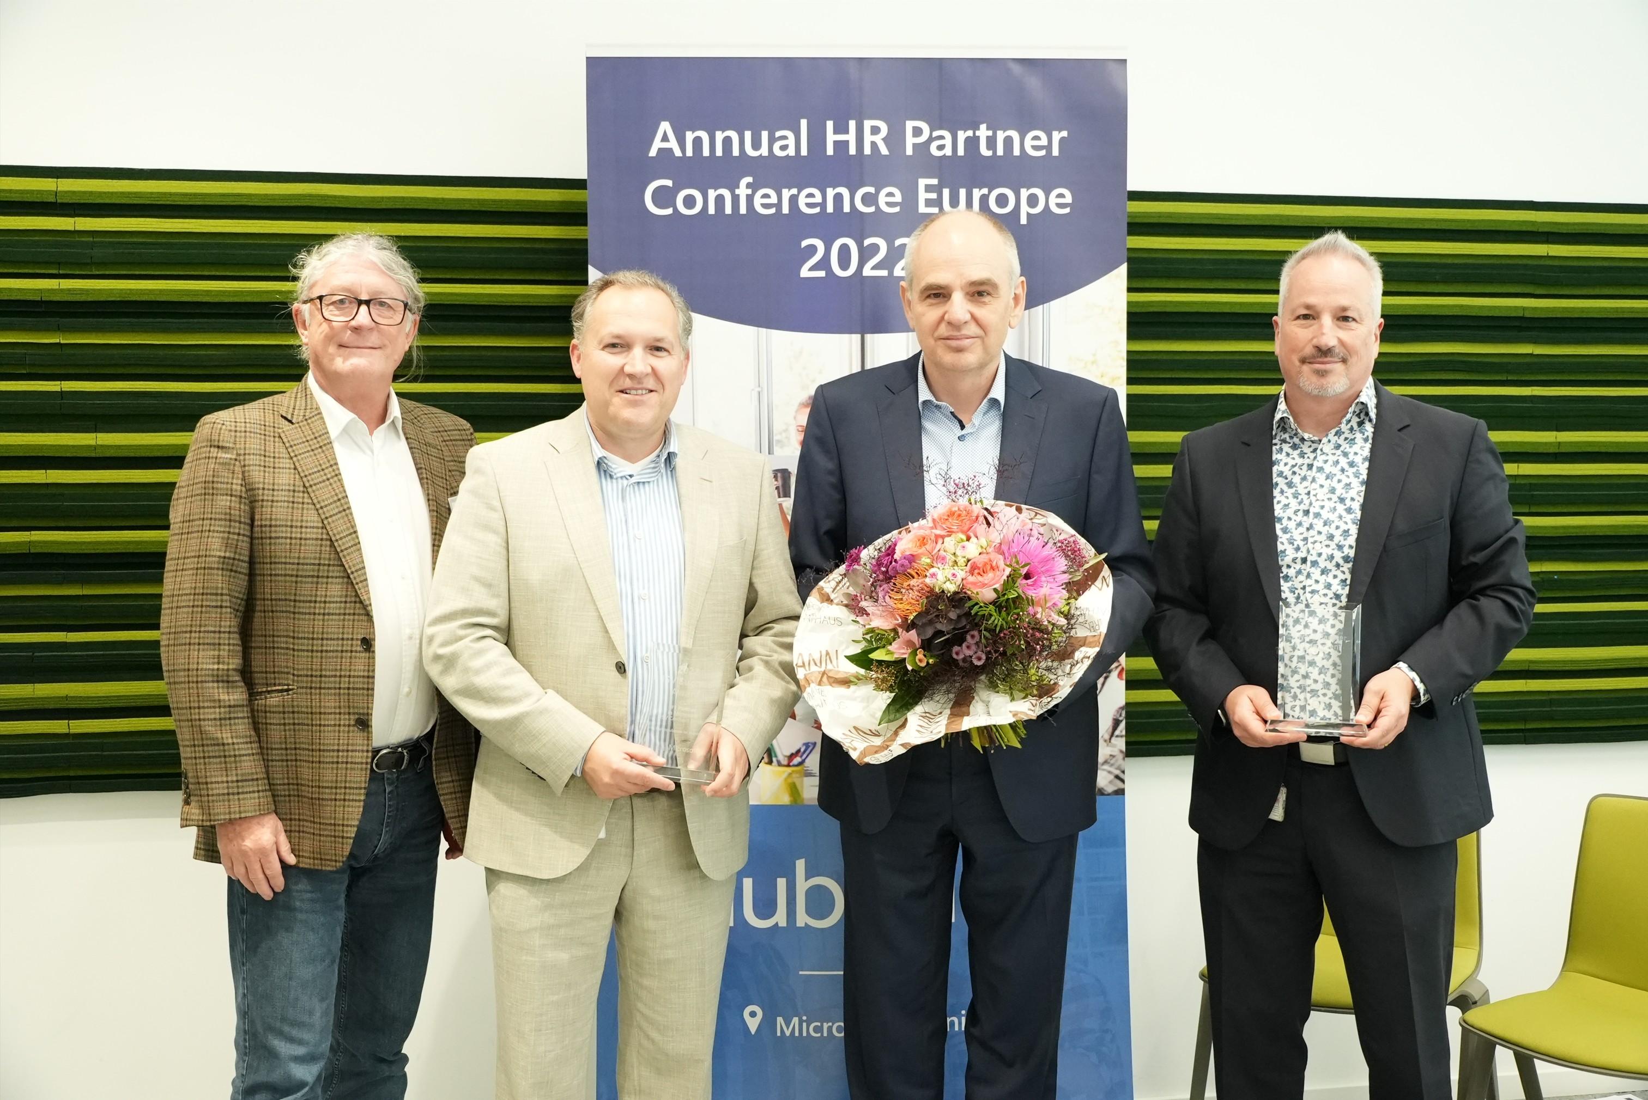
The most successful Microsoft ISV
Hubdrive is the most successful Partner by ISV revenue for Microsoft

Slide 20
How did it really start?
Thank you very much for your hard and excellent work building your HR solution and addressing the worldwide HR market opportunity together with Microsoft.
Your company, your solution and go-to-market model is a very good example for many other ISVs to win in the new Cloud world.
Thank you very much again and let´s win the HR market together.
Jean-Philippe Courtois
Executive Vice President and President, Microsoft Global Sales, Marketing and Operations

Slide 21
Hubdrive and Microsoft Joint Venture – very personal
C-Level Engagement
Joint Marketing
Co-Sell
Roadmap
0
Franziskus Lorey (CEO Hubdrive)
and Jean-Philippe Courtois
(Board Member)
Gavriella Schuster (Corporate Vice President)
Advertising, Joint Campaigns, PR
Co-Sell in 36 countries
Joint approach for large customers and SMEs Co-Sell
Roadmap Coordination
John Bergman (Product Manager)
James Phillips (Vice President)

Slide 22
Hubdrive & Microsoft Joint Venture
Supported by Jean-Philippe Courtois

Slide 23
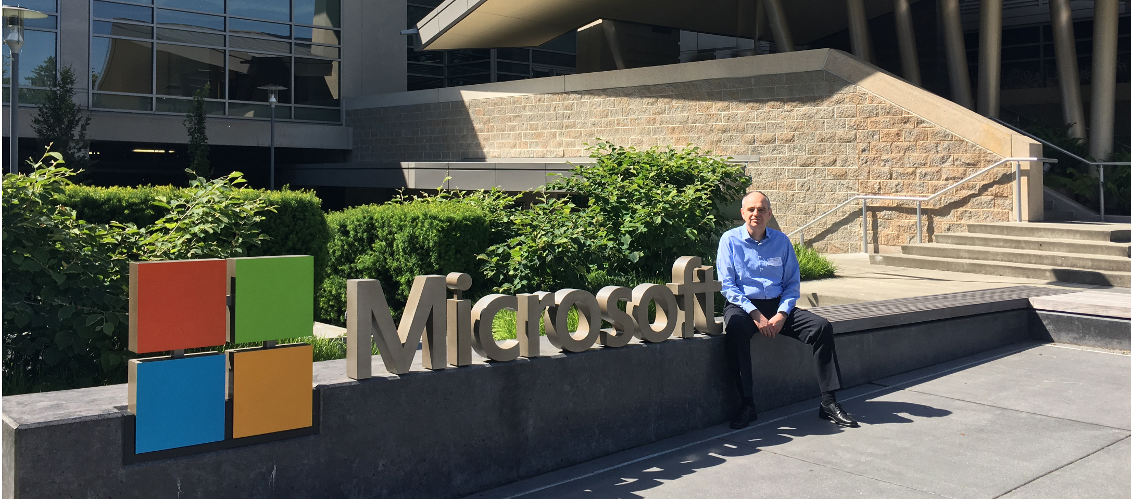
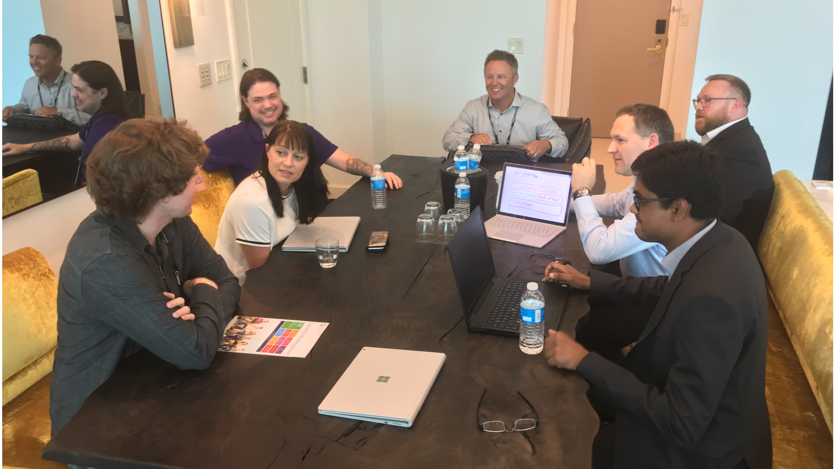
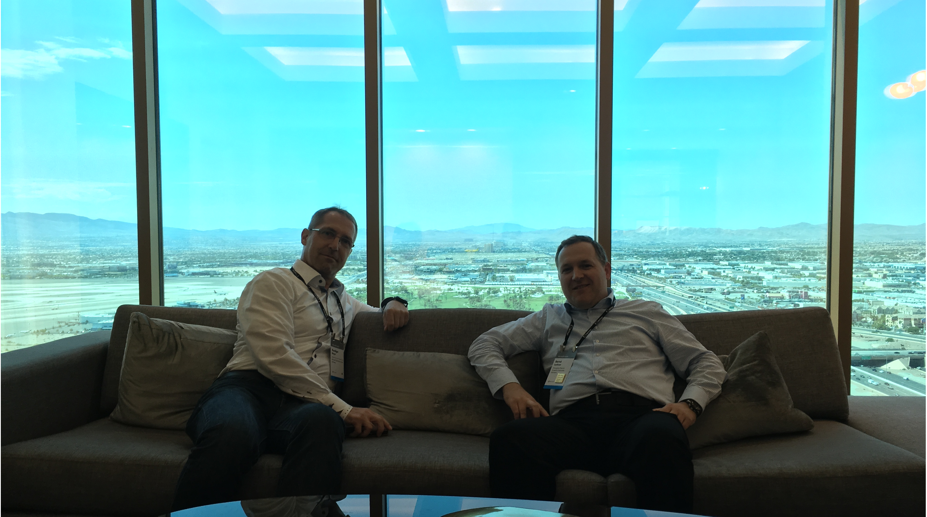
Hubdrive and Microsoft Joint Venture on a personal level

Slide 24
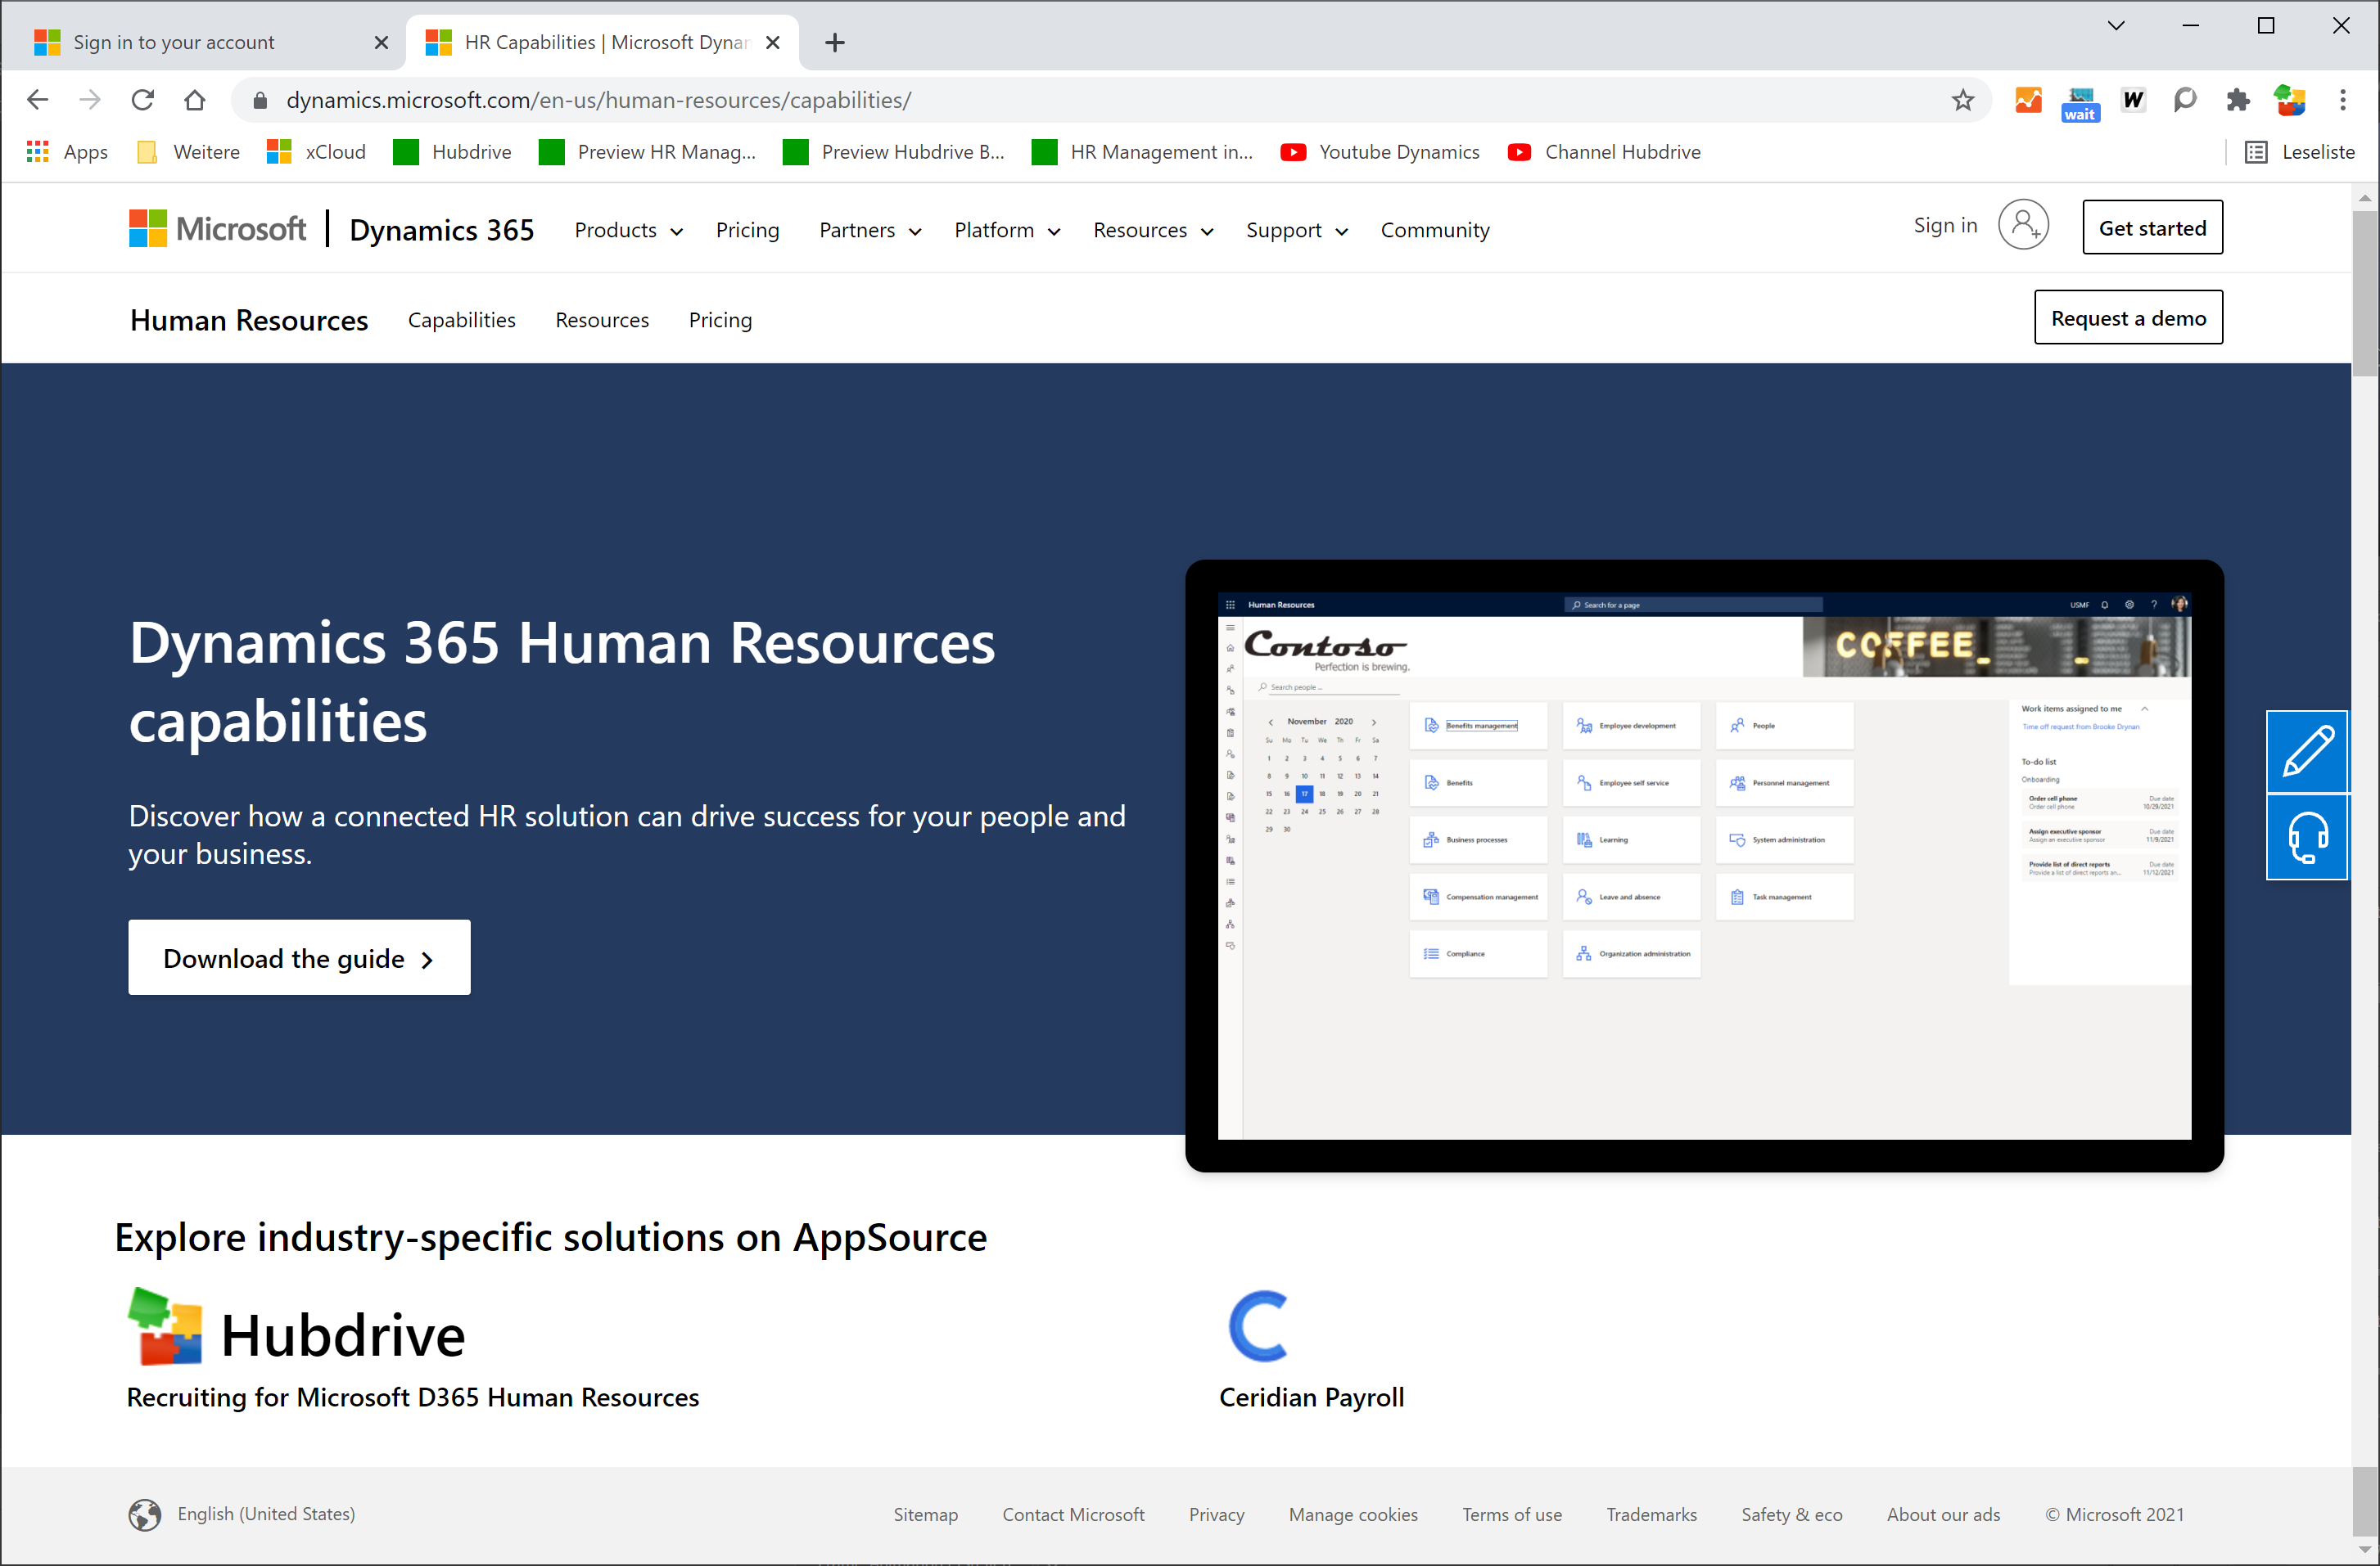
Digital Promotions
Offering Hubdrive HR solutions
on Microsoft Website

Slide 25
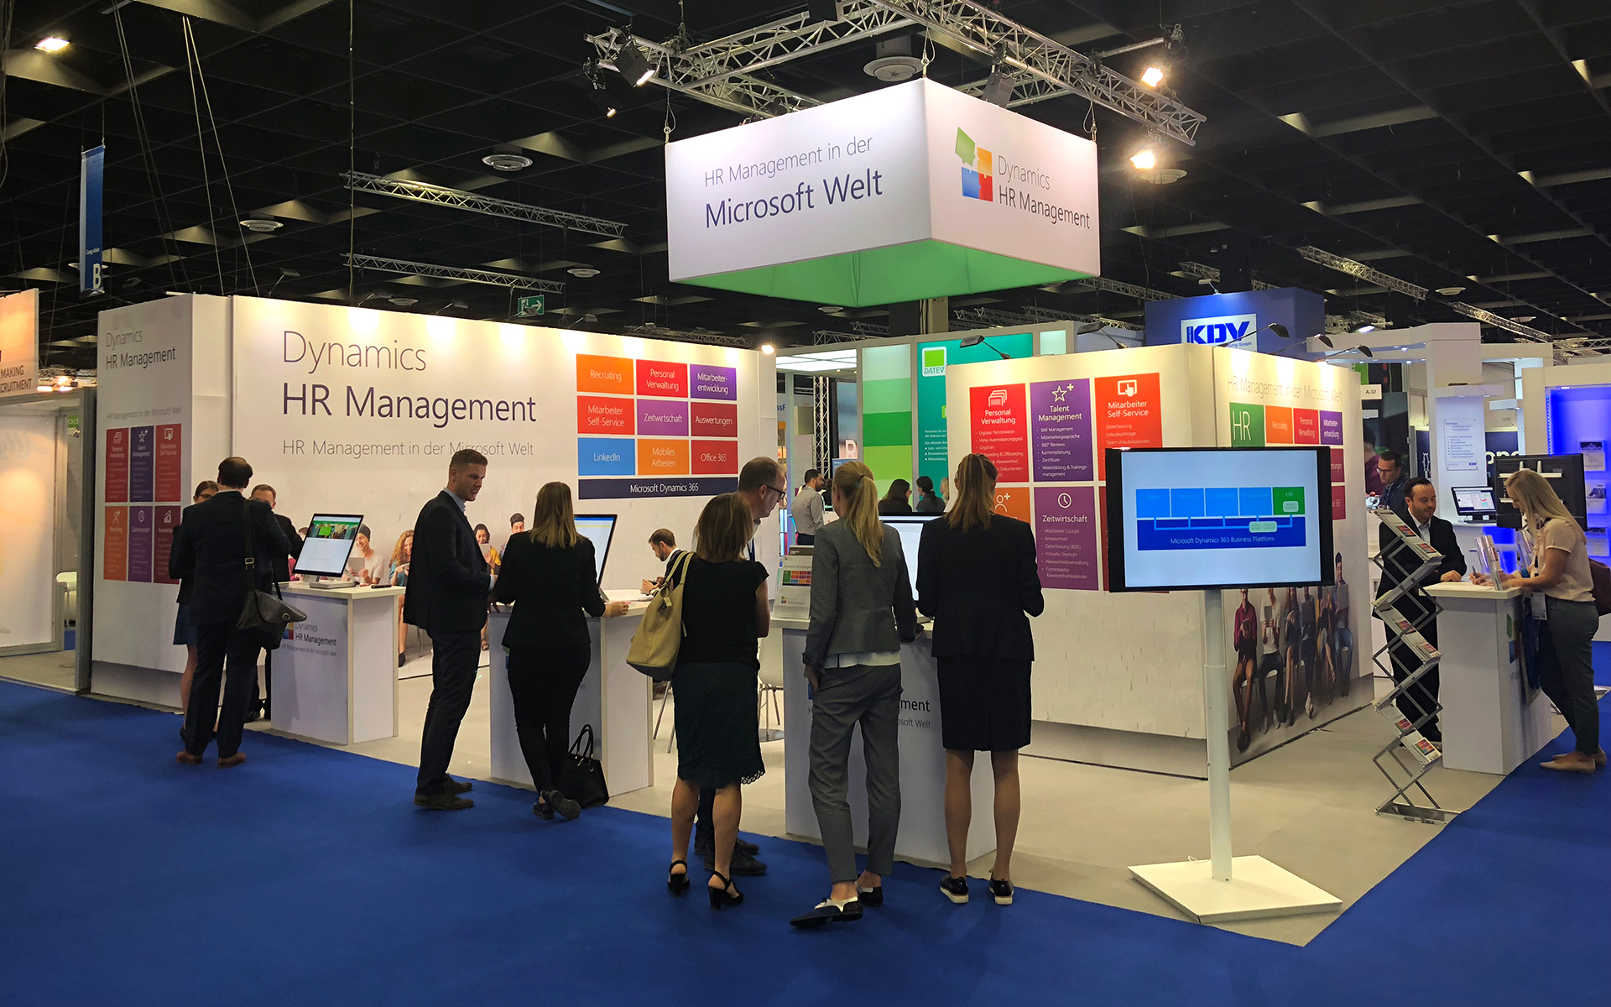
Joint Marketing
Local HR Fairs Co-Presence
Customer Webinars
Notes:
Update the Dynamics HR Management

Slide 26
AppSource Celebration
AppSource Celebration
Filming 1000 Leads
in a month for Hubdrive

Slide 27
References
Customer base and testimonials

Slide 28
Hubdrive Customer References
Add DB, Porsche, MSC
Notes:
Option 2: These are some really exciting customers that we have

Slide 29
Excerpt Customer List
Software you can trust in
HR for Dynamics is a worldwide deployed Software that you can trust

Slide 30
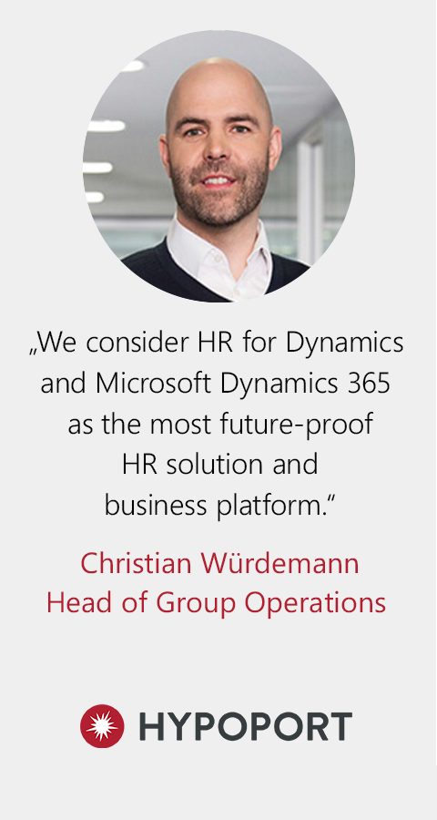
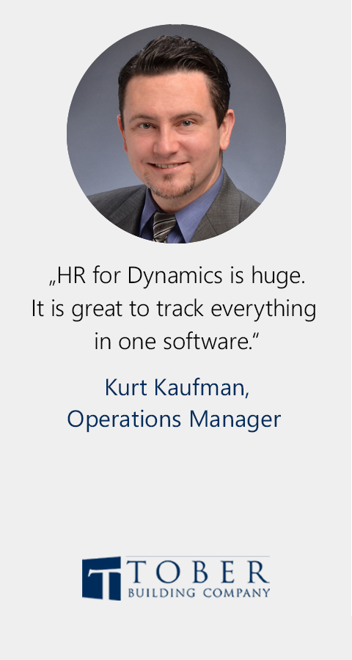
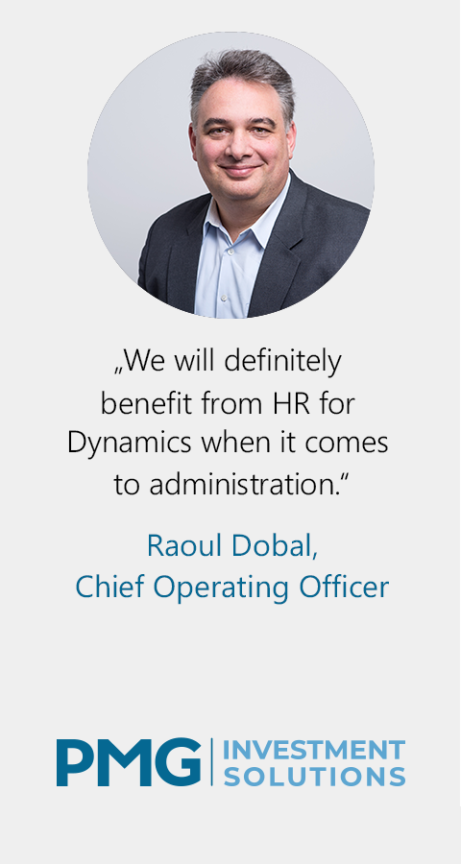
Hubdrive HR Customer Testimonials
We would love to win you as our next customer

Slide 31
Hubdrive fulfilled our important requirements as well as our additional wishes.
Solution Approach
The cloud-based Dynamics HR Management solution from Hubdrive has eliminated dependence on paper documents and duplicate data entries in more than one system. All relevant overviews and reports are now digitally displayed and viewable.
The Employee Self-Service has enabled employees to submit requests for leave and this has eliminated the paper trail.
The manual administrative effort for the Human Resource department has been greatly reduced. Particularly the Best Practice processes have made employee attendance management across the many locations much more efficient.
Benefit
The HR department has been freed from many administrative tasks due to the automation in Dynamics HR Management, and they save time on data maintenance and searches. The HR team can now concentrate on soft HR competencies such as training and development.
The solution is easy to use for both HR employees and Port Authority staff. It takes port workers much less time to apply for and view their remaining leave.
It is now much easier for supervisors to keep track of their employees. The cloud-based solution enables them to know which team member is currently working in which of the various ports.
This makes it much easier to stay within their budget.
Learn more =>

Slide 32
We consider HR for Dynamics from Hubdrive and Microsoft Dynamics 365 as the most future-proof HR solution and business platform.
Solution Approach
Through an extensive multi-stage selection process, it turned out that there was exactly one HR solution on the market that could meet all these expectations: HR for Dynamics by Hubdrive. HR for Dynamics is a complete solution that met all the functional requirements of the 15 Hypoport subsidiaries. Only HR for Dynamics was innovative and intuitive at the same time – just like employees are used to it from Office 365, Google and Facebook.
In addition, the adaptability is enormously high and the customizing easy to implement. Despite the individuality of the subsidiaries, this ensured a high degree of automation.
Benefits
With HR for Dynamics, we are drawing full potential of digitalization. The solution has enabled us to eliminate IT islands and automate a large number of HR processes which led to high savings. The perfect fusion of Business (Microsoft Dynamics 365) and Workplace applications (Microsoft Office 365) further increases efficiency.
The employees are excited about the scope of functions of HR for Dynamics 365 and the high degree of automation. As a result, a lot of repetitive HR-work could be eliminated and Hypoport’s agile requirements could be fulfilled.
Learn more =>

Slide 33
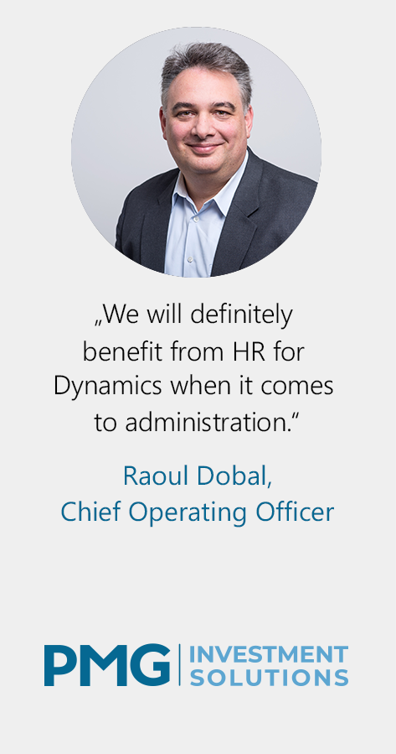
We will definitely benefit from HR for Dynamics when it comes to administration.
Solution Approach
HR for Dynamics is a holistic complete solution for HR which is based on a Microsoft platform and thereby fulfills the most important requirement of PMG.
Due to HR for Dynamics, HR and Managers can be relieved from administrative tasks: a comfortable self-services portal enables employees to easily maintain a lot of data themselves and automated workflows create structure in the HR area. For example, managers are regularly reminded to conduct employee interviews and existing templates reduce the organizational effort which is required for reviews. This means that there is more time and focus left for the really important topic - the employees.
Hubdrive, the manufacturer of HR for Dynamics, has its headquarters in Germany and this means that they are culturally very close to PMG in Switzerland. Many Swiss country-specific topics in the HR area are already included in the standards of the solution.
Benefits
Due to HR for Dynamics, PMG gains comfort and saves a lot of time. All IT islands like Word- or Excel documents are replaced with one single solution. With HR for Dynamics, PMC creates structures in the HR area and automations secure workflows as well as the currency of data.
Significant productivity gains can be achieved across all employees for PMG. Not only by using self-service functions but also by administration of employees without access to the system, the workload for administrational HR tasks for managers can be reduced significantly.
Overall, significant productivity gains, clearer processes and thus efficient handling of recurring HR processes were implemented. This frees up valuable and specialized human resources.
Learn more =>

Slide 34
Facts and Figures
KPIs about Hubdrive

Slide 35
Facts and Figures
Founded Year 2002
Customers and Partners 1000+ License Customers in 36 countries 120+ Reseller worldwide 20+ Alliance Partner
Sustainability and Growth 35%+ average growth last 5 years in revenue, staff and worldwide presence.
Customers by segments Small firms: 10% Mid size companies: 25% Large companies: 57% Large enterprises and groups: 8%
Employees Number of employees: Category 51-200
Owner Franziskus Lorey & Bernd Lachner
Financing Franziskus Lorey, Bernd Lachner and Government KFW Group: www.kfw.de
Headquarter Würzburg, Germany

Slide 36
7 Things Hubdrive does different
HR Management for Microsoft Dynamics 365

Slide 37
HR Complete Solution

for Microsoft Dynamics 365
HR
Recruiting & Onboarding
Staff Administration
& Automation
Digital Personnel File & Documents
Talent & Performance Management
HR Management Software for
Microsoft
Dynamics 365
Time & Attendance
Leave & Absence
Travel & Expenses
Training & eLearning
Employee Self-Services
Manager Self-Services
Compensations & Benefits
Reporting & Analytics
Leadership & Management
Country & Industry Templates
Office 365 for HR
Modern Workplace
Microsoft Dynamics 365 Business Platform
© Hubdrive.com

Slide 38
Integration out of the box

Save time, money and increase security.
For you
Integrated working out of the box
IT Islands
Status Quo in many companies
Marketing
Sales
HR
Service
Finance
Marketing
Sales
HR
Service
Finance
vs.
Microsoft Dynamics 365

Slide 39
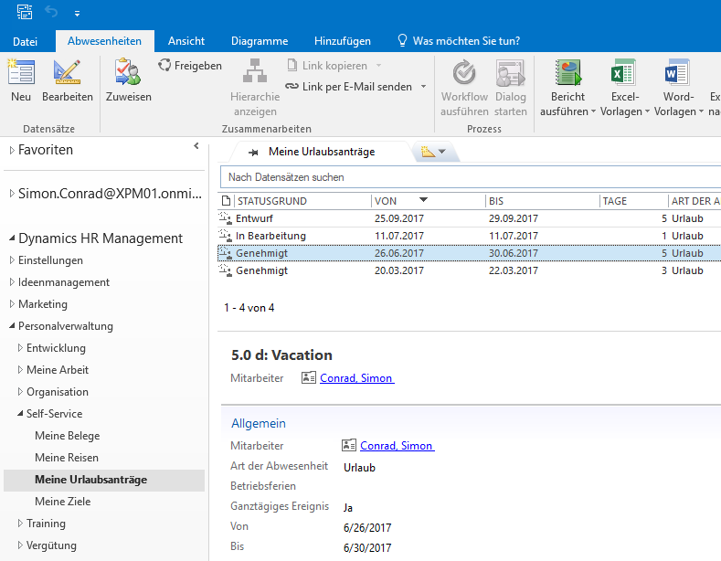
Flexible work environments

With a tablet, PC, smartphone, notebook, in the browser, in Microsoft Outlook or Teams
HR in Browser
HR in Outlook
HR in Teams
Mobile HR

Slide 40
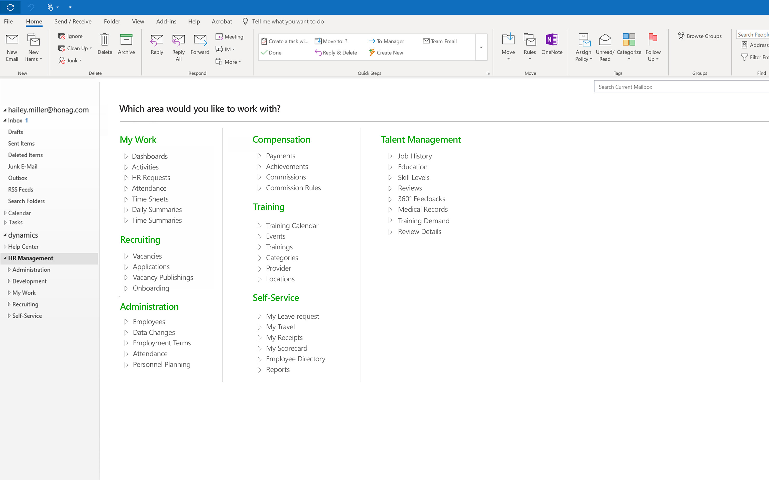
All HR tasks in your familiar Outlook
Complete your entire HR work in the familiar Microsoft Outlook: from recruiting to employee development, all GDPR compliant.

Slide 41
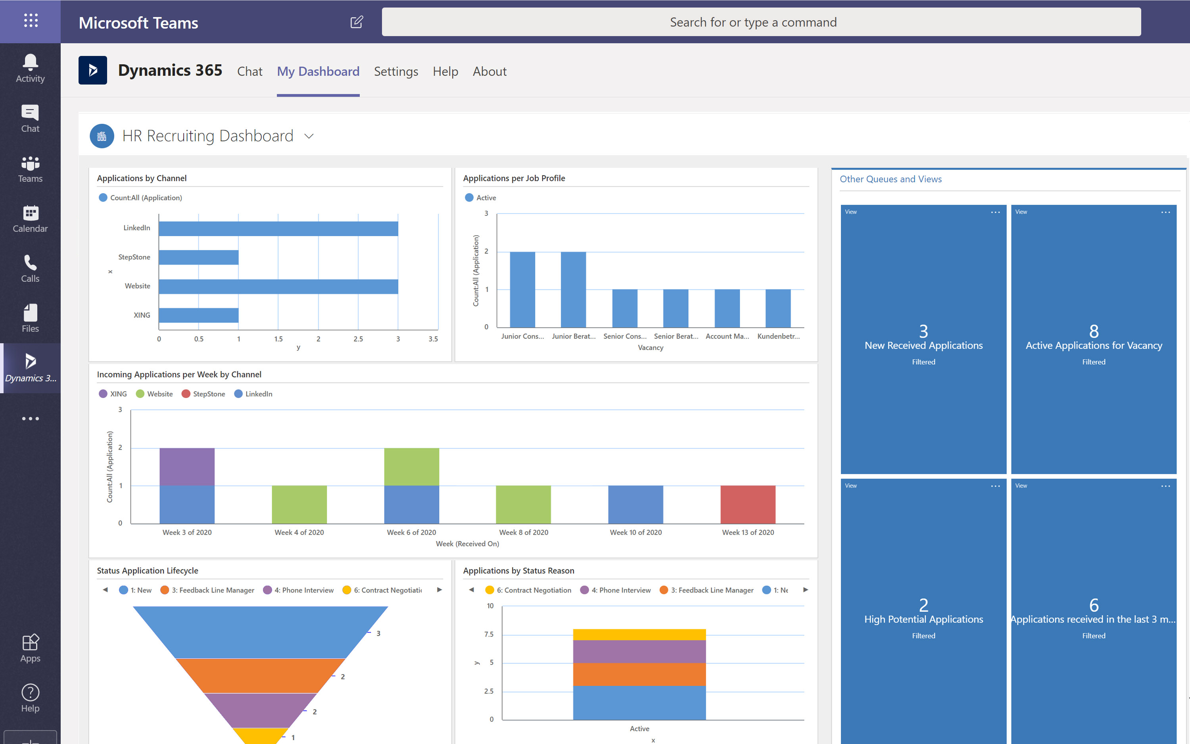
HR Management tasks with Microsoft Teams
Dashboards, Reports, HR Chat – full transparency with one click

Slide 42
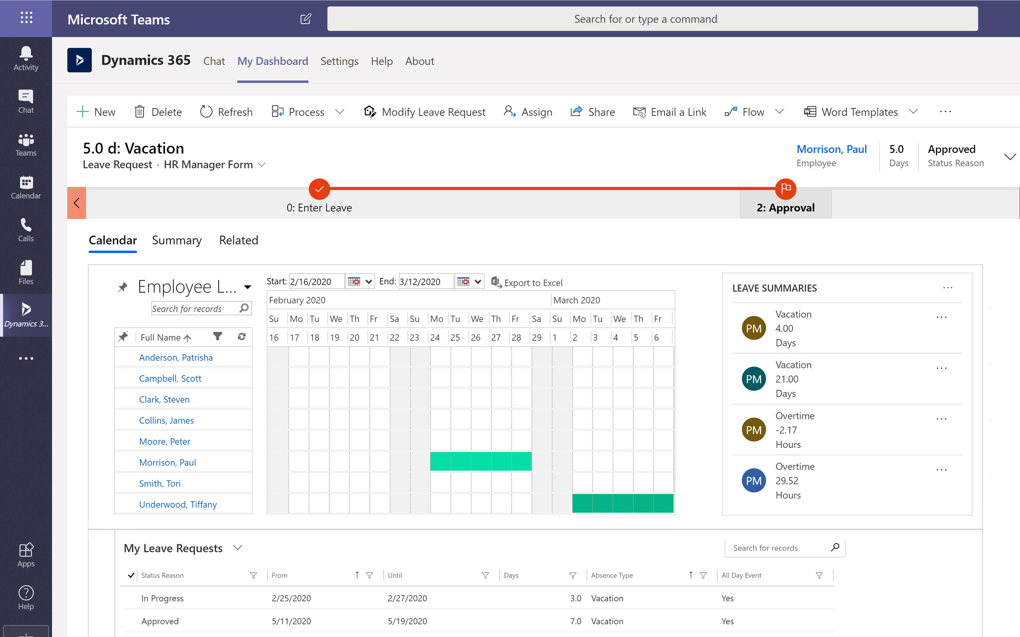
HR Tasks & Self-Services with Microsoft Teams
Dashboards, Leave Requests, HR Chat, Time Tracking, Applicant Video Conference etc.

Slide 43
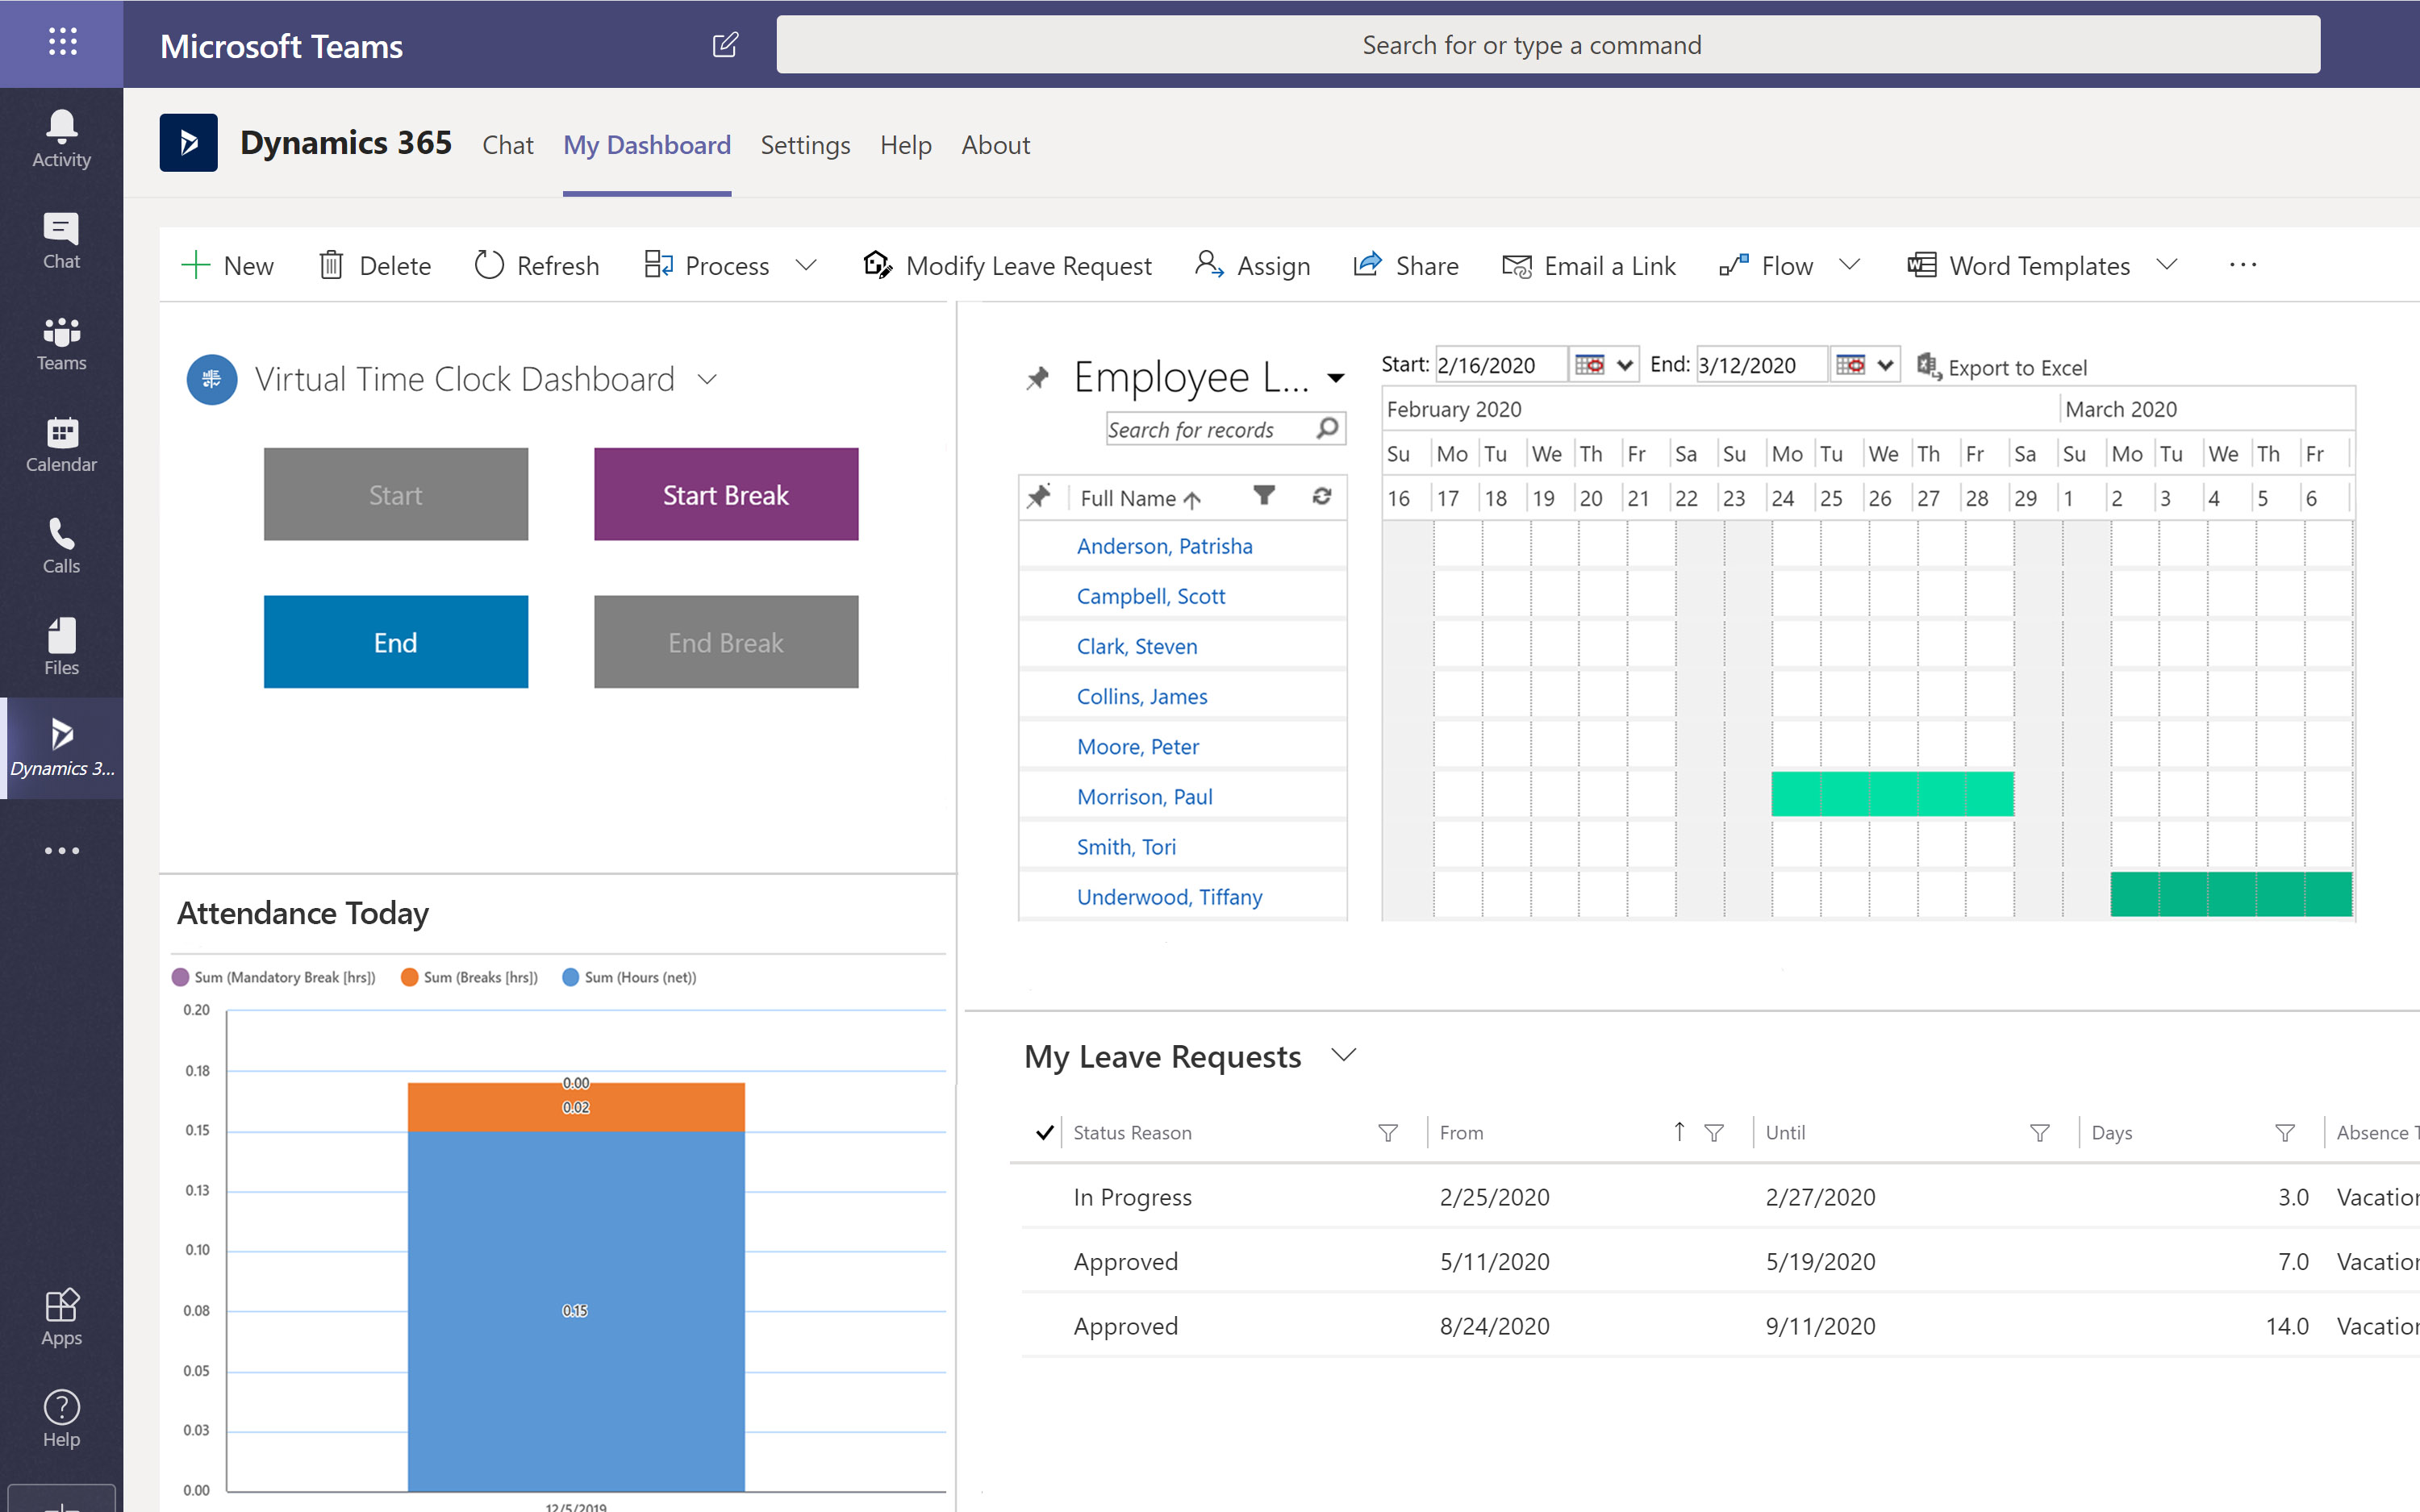
HR Tasks & Self-Services with Microsoft Teams
Dashboards, Leave Requests, HR Chat, Time Tracking, Applicant Video Conference etc.

Slide 44
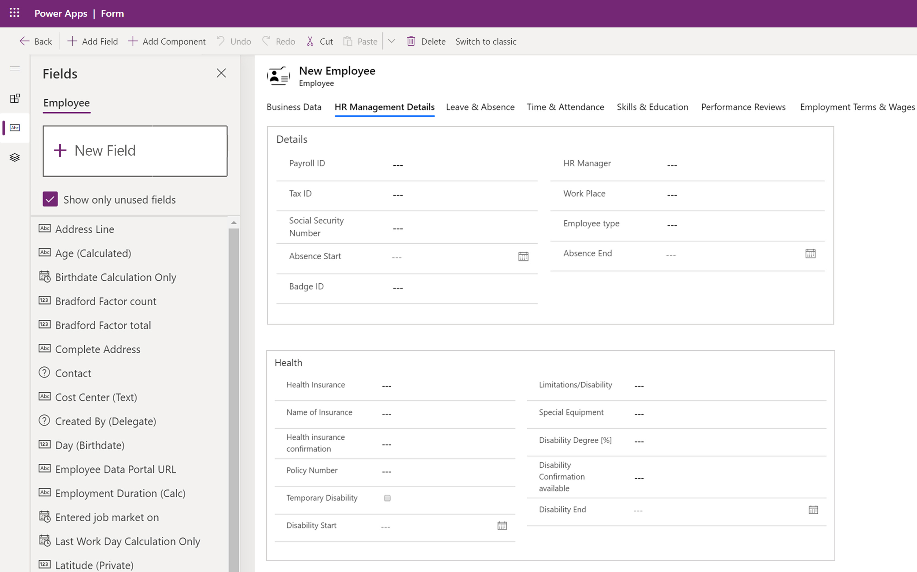
Customize the solution yourself

Simply Drag & Drop
Simply adjust the solution yourself in 5 minutes

Slide 45
Easy adaption of workflows
User’s View
To change the order of your workflow
Customizing View
Simply drag-and-drop the element

Slide 46
HR Analytics
Company-wide always up to date thanks to the Microsoft Dynamics 365 Platform
Dashboards in Teams
Excel - Export
Excel - Dynamic
Power BI

Slide 47
Excel Reports always up-to-date
Excel reports remain connected to the HR solution.
You will automatically have current data from HR for Dynamics in Excel tables and charts.

Slide 48
Payroll Preparation
Automated Payroll Preparation
of salaries and commissions, up to master data changes such as hourly account

Slide 49
Your Windows Password for all tasks

Legacy
HR Software
20+ Passwords
Modern
HR Apps
10+ passwords
Innovative
HR for Dynamics
ONE password
Many solution
islands
One central HR database
Integrated
working
1
OneDrive
Your
Windows
4
4
1
Teams
Sales
HR
4
Payroll
1
1
4
4
HR
HR
Marketing
Sales
HR
Service
Finance
Recruiting
Time Tracking
Receipts
Intranet
Payroll
ERP
Recruiting
Time Tracking
Receipts
Intranet
Payroll
ERP
Recruiting
Time Tracking
ERP
Receipts
Intranet

Slide 50
Implementation in weeks

Improvement established in weeks
Best Practice Implementation = Solution live in 8 weeks
At the touch of a button




Implementation Planning
Best Practice Training and eLearning
Adaptions and rollout per module
Continual Improvements
2 days
2-4 weeks
2-4 weeks
continuously
>>>>>>>>>>>>>>> SMB+C Implementation in 8 weeks >>>>>>>>>>>>>>>

Slide 51
Contact us
USA +1 (917) 410-3344
Great Britain +44 (20) 3787 4027
Hong Kong +852 3008 2535‬
Brazil +55 (21) 2018-3036
Germany +49 (931) 660-8444
Mia.King@Hubdrive.com

