Slide 1
Benefit Check
HR & Microsoft Dynamics 365 Platform

Slide 2
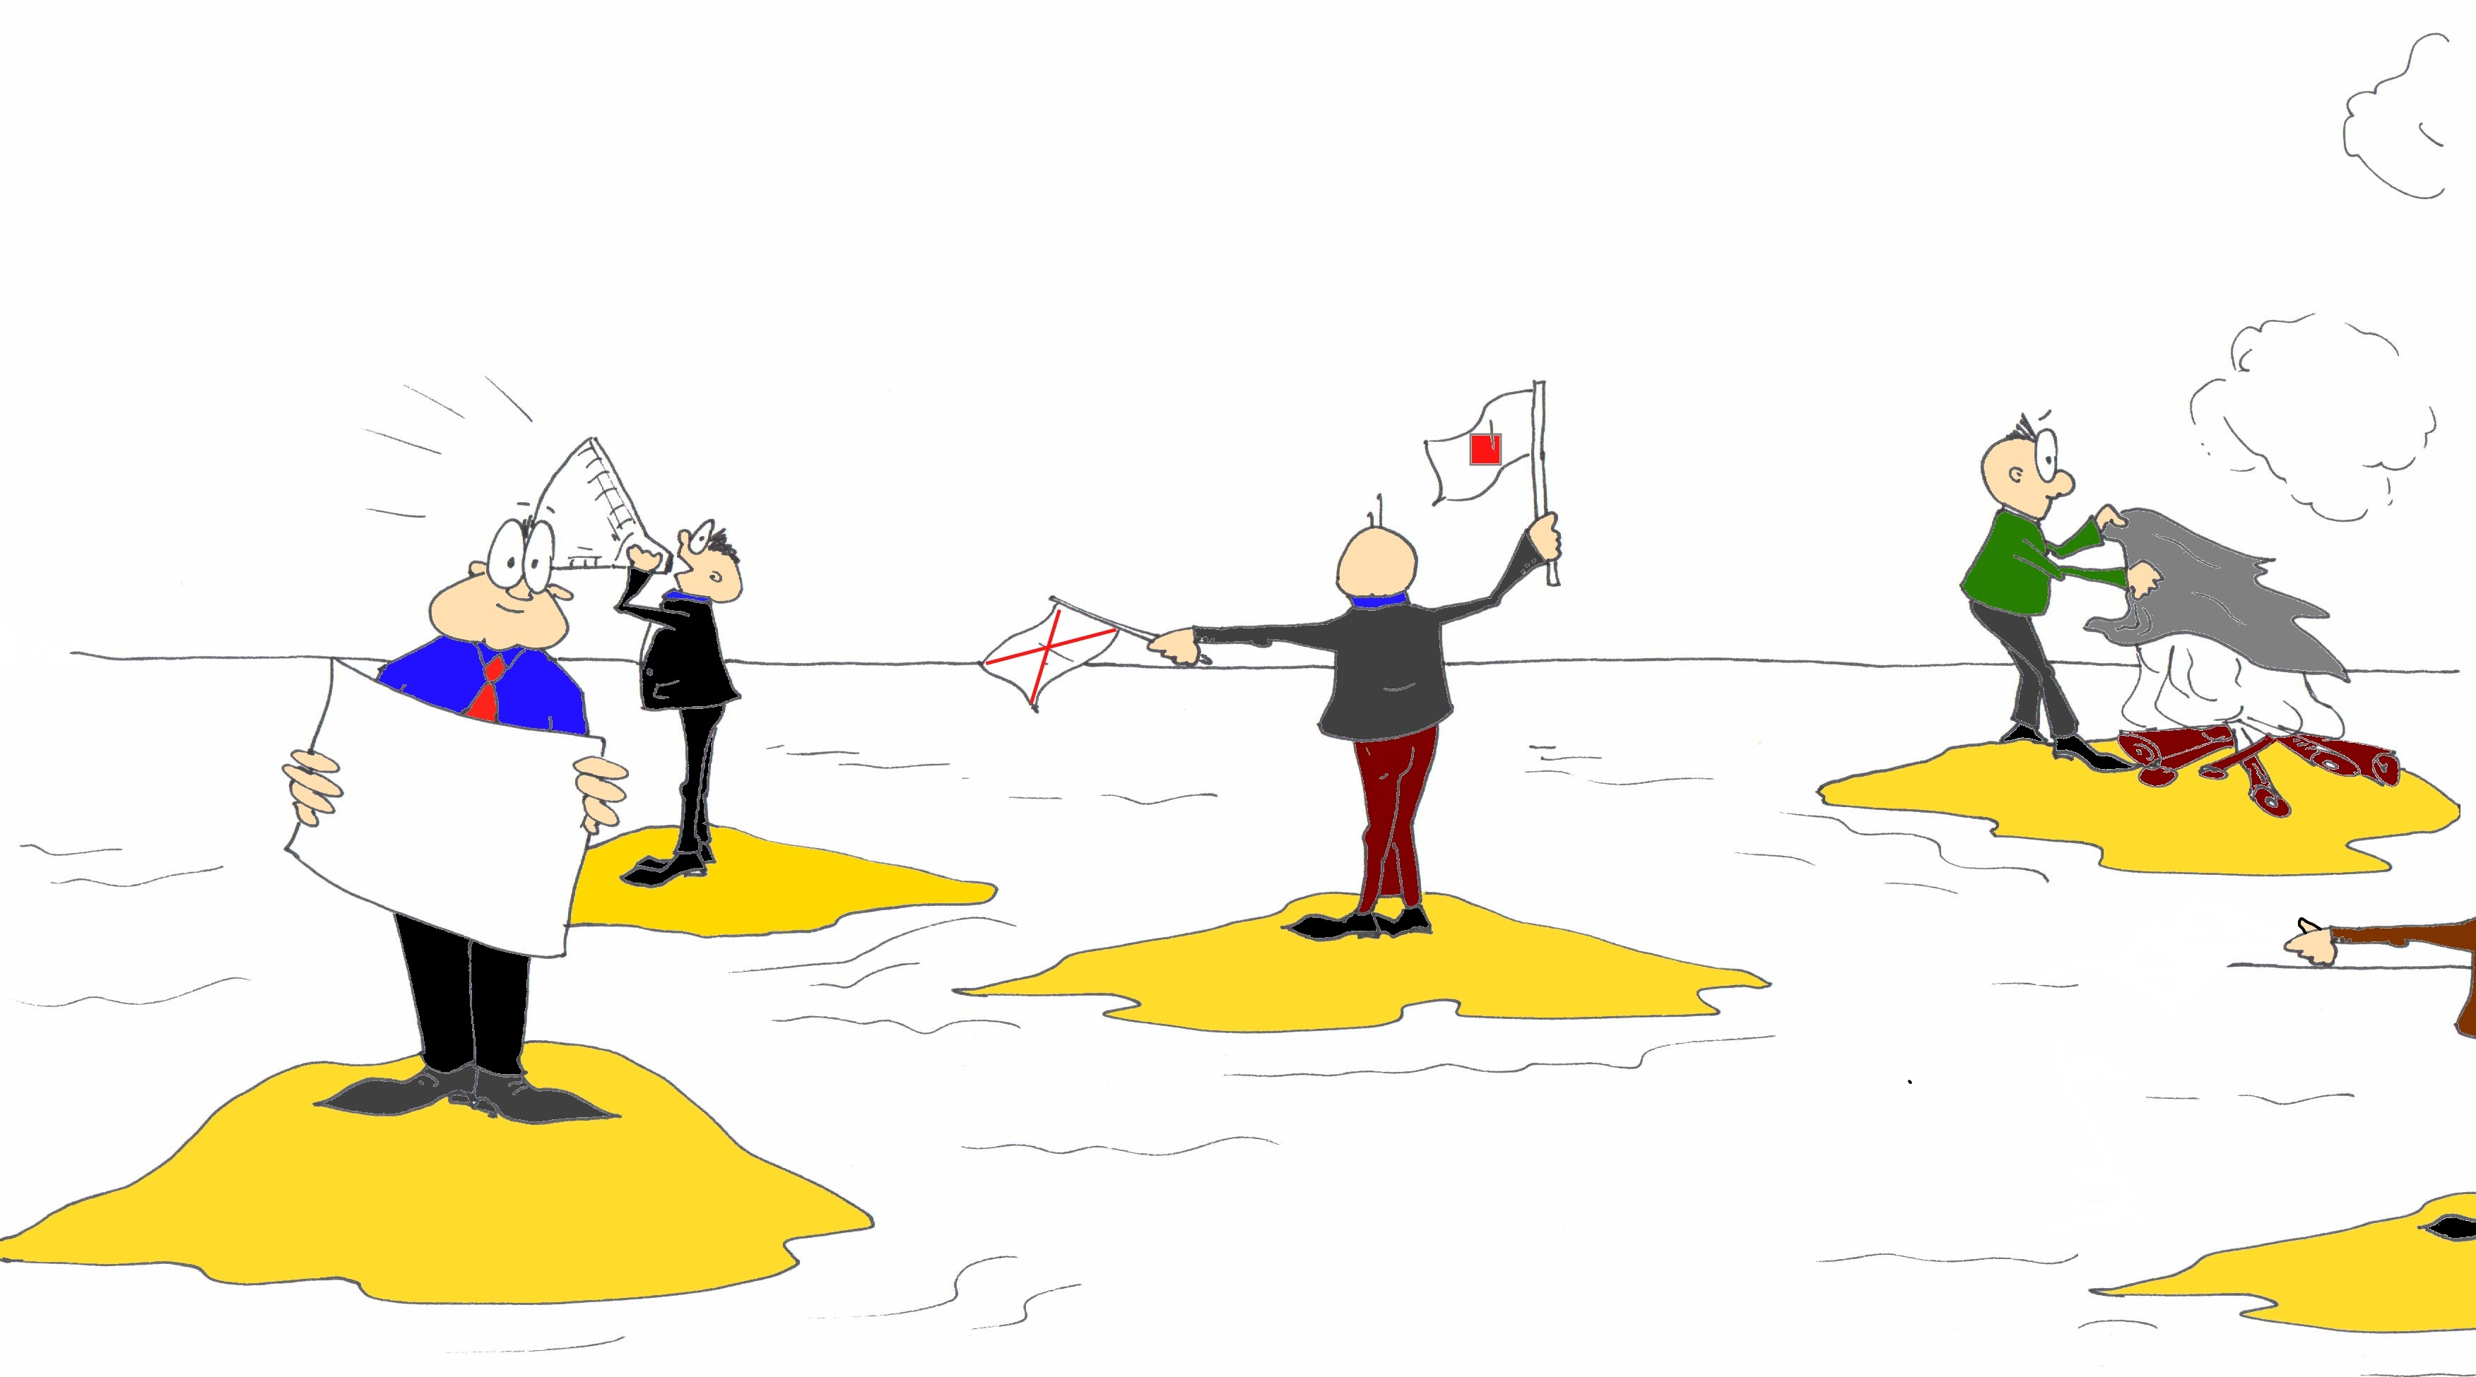
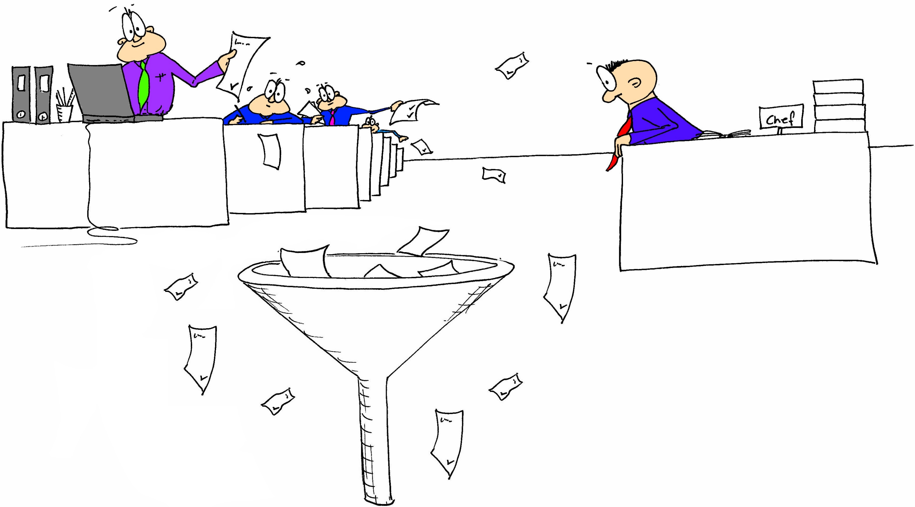
From paper and IT islands to a constructive cooperation
☺

Slide 3
Integrations instead of IT Islands
Save time, money and nerves.
For You
Out of the box
IT Islands
Status Quo
Marketing
Sales
HR
Service
Finance
Marketing
Sales
HR
Service
Finance
vs.
Microsoft Dynamics 365

Slide 4
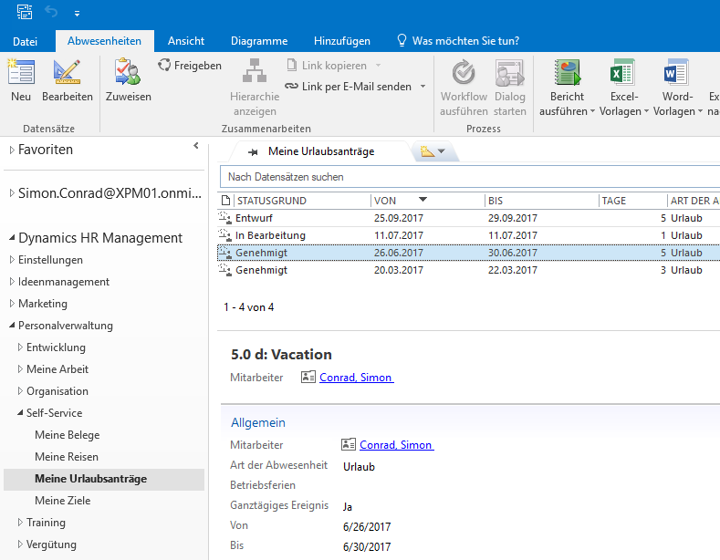
Innovative HR Management
Take the easiest and most convenient way
Browser
Outlook
Teams
Mobile
Are we not all individual?
Productivity thanks to simple, intuitive and individual work.

Slide 5
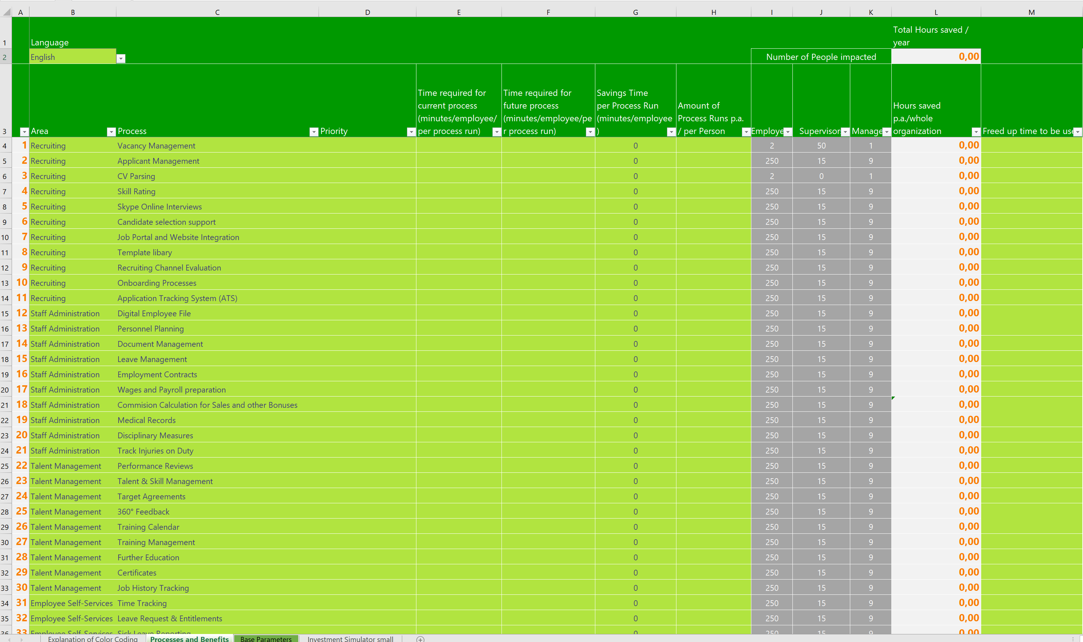
Process Analysis
Standardized query and development

Slide 6
Select the relevant modules
HR
HR Management for Microsoft
Dynamics 365
Recruiting
& Onboarding
Staff Administration
& Automation
Digital Personnel File
& Documents
Talent
Management
Time
& Attendance
Leave
& Absence
Travel
& Expenses
Training Organisation
Self-
Services
Reporting & Analytics
Modern
Workplace
Office 365
& HR
Microsoft Dynamics 365

Slide 7
Modul | Interview Role | Time (h)
Recruiting & Onboarding | Recruiter | 1,5
Staff Administration & Automation | HR Manager & HR Administration | 1,5
Digital Personnel File & Documents | HR Manager & HR Administration | 1,5
Talent Management | HR Development Manager & HR Administration | 1,5
Time & Attendance | HR Manager and & HR Administration | 1
Leave & Absence | One Head of Department & HR Administration | 0,75
Travel & Expenses | One Head of Department & HR Administration | 0,75
Training Organization | HR Development Manager & HR Administration | 1
Self-Services | Employee & HR Administration | 1
Reporting & Analytics | Head of HR, CXO, Managing Director, Head of Department | 1
Modern Workplace | Employee, Head of HR | 0,75
Office 365 & HR | HR Manager & HR Administration | 0,75

Slide 8
Agenda BenefitCheck – Modules:
Short presentation of participants and goal of the appointment
Internal moderator (participates in all appointments)
Presentation of current working methods and desired improvements
See slide internal roles
Presentation of additional improvement possibilities
External HR expert
Joint evaluation
Attendees with experience in the respective topic
Summary and documentation of the results
External HR expert

Slide 9
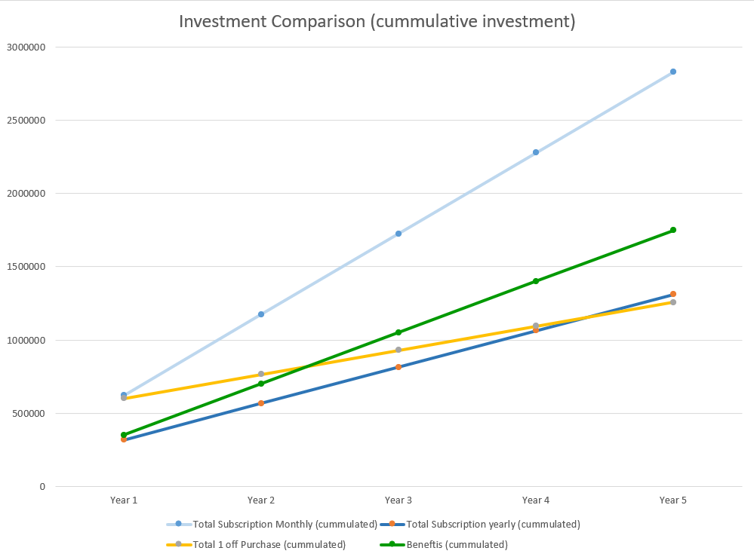
Results of the Evaluation: Break Even

Slide 10
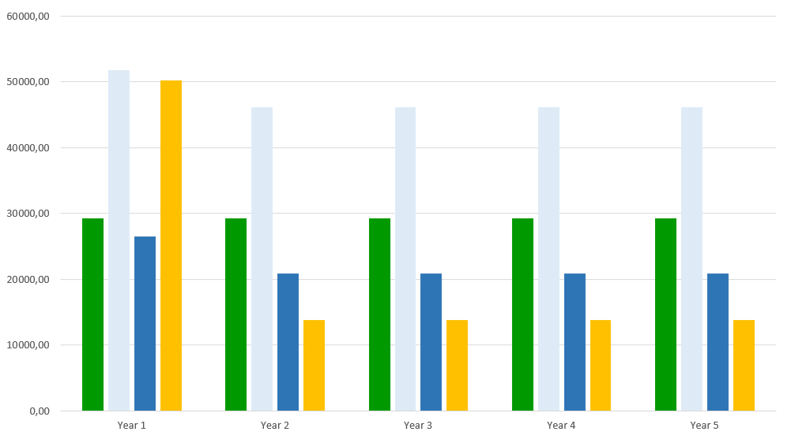
Results of the Evaluation: Break Even

